Slide 1
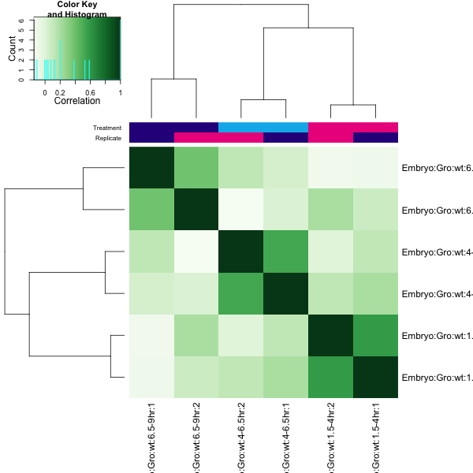
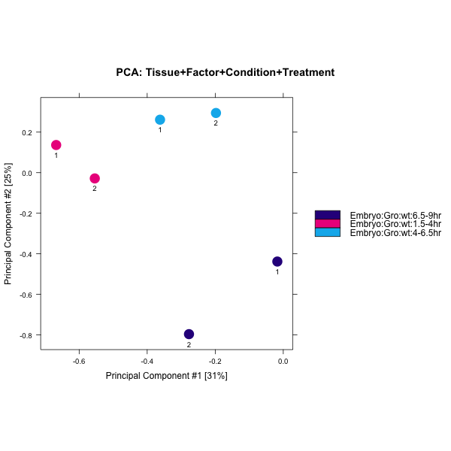
A
B
C

Slide 2
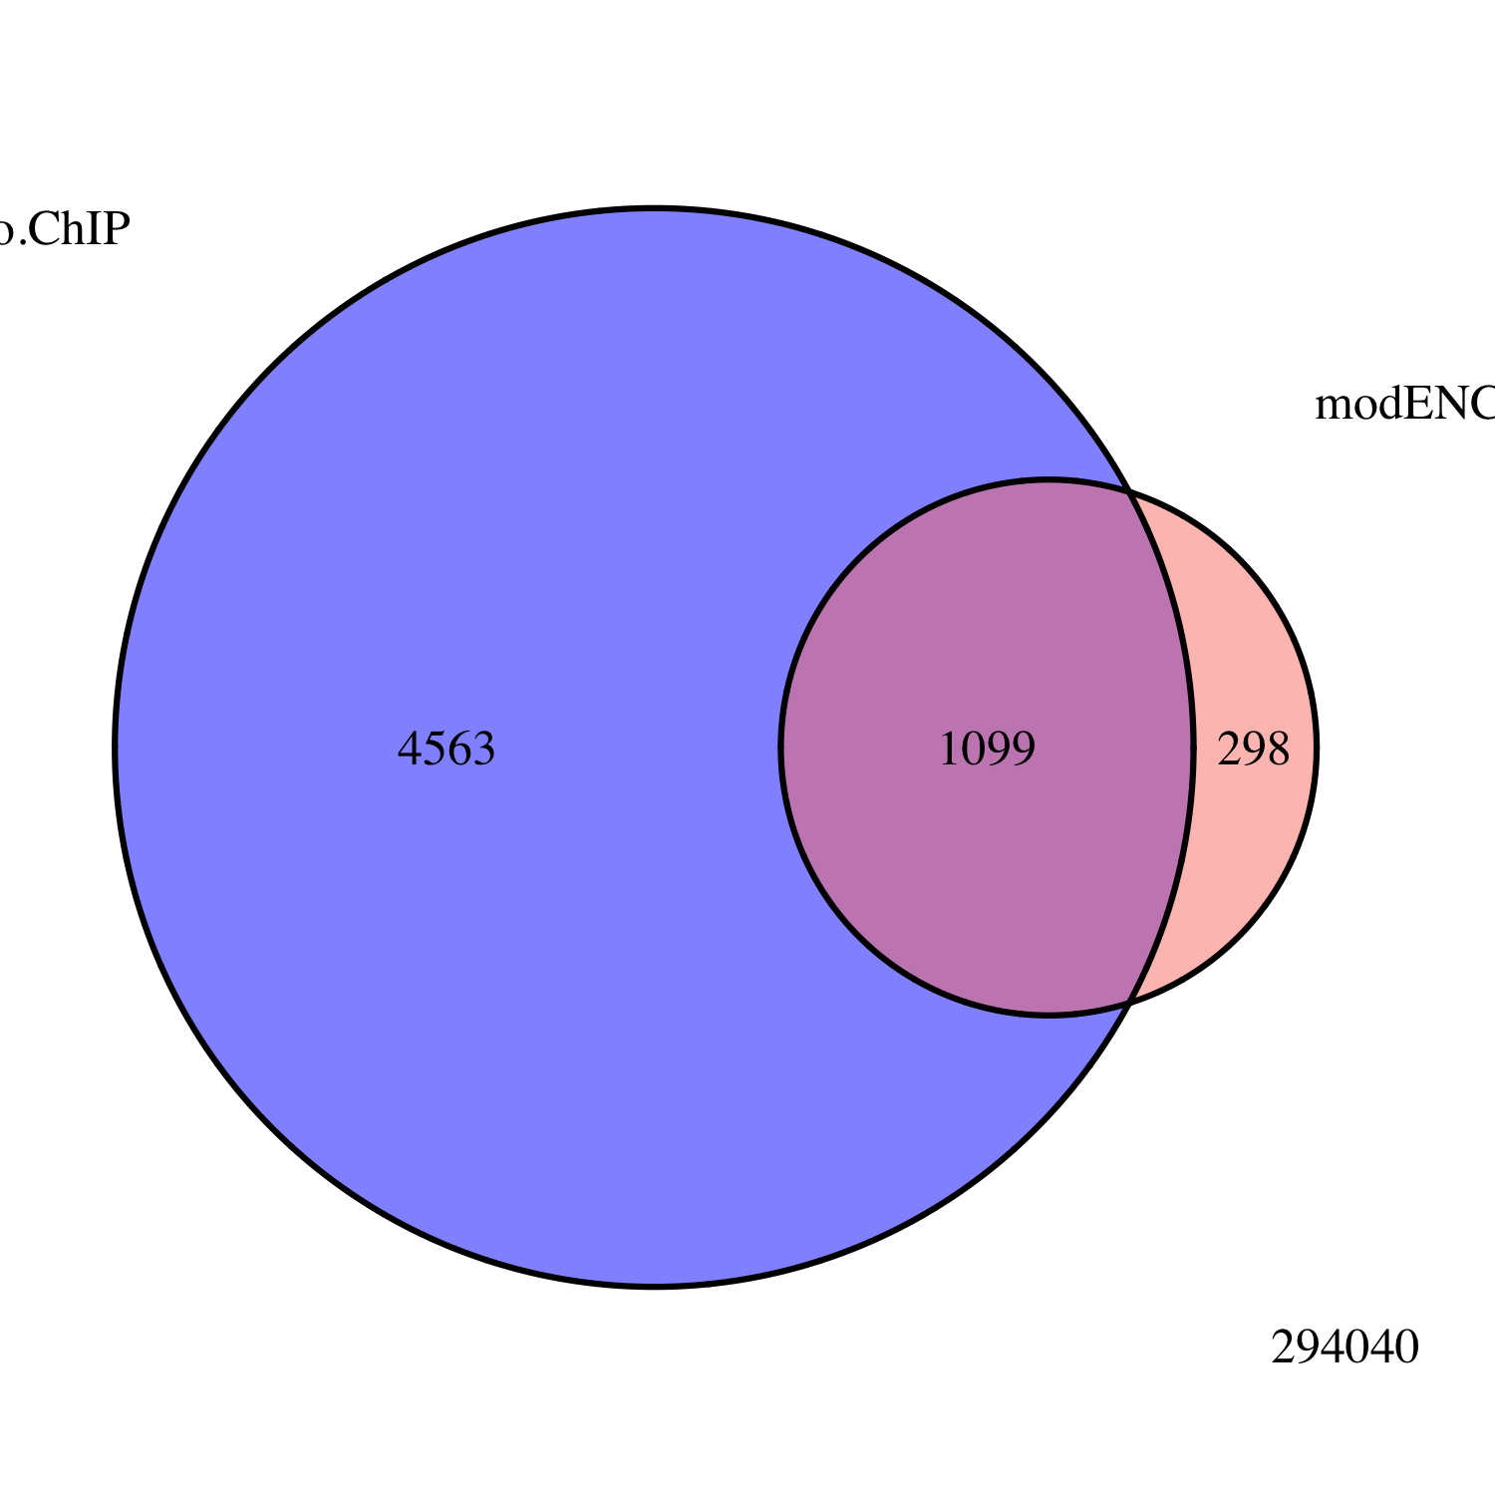
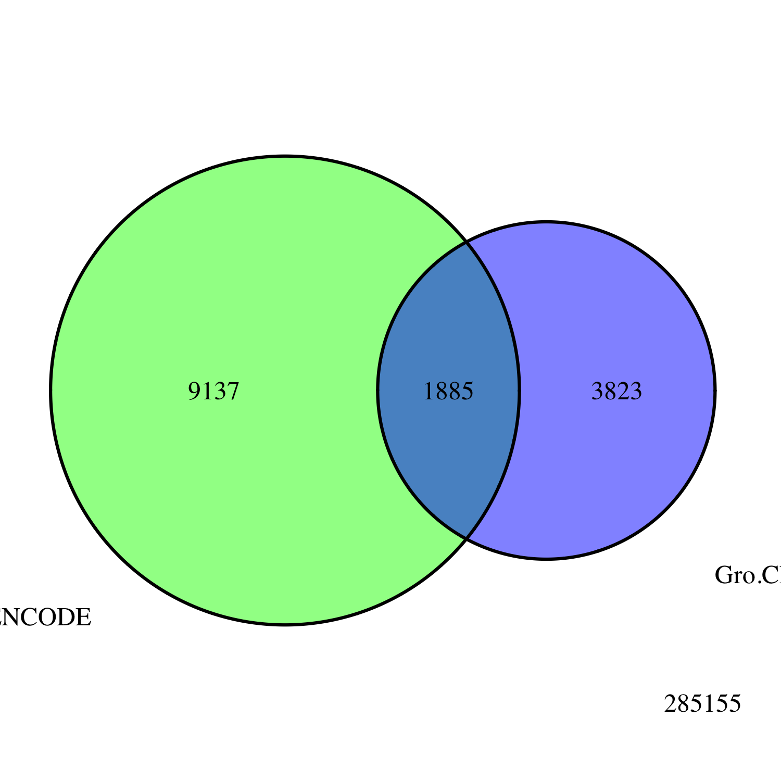
A
Embryo
Gro ChIP-seq
All Peaks
modENCODE
Embryo
Gro ChIP-chip
B
Embryo
Gro ChIP
All Peaks
3823
modENCODE
White Pre-Pupae
Gro ChIP-chip
1885
9137

Slide 3
A
B

Slide 4
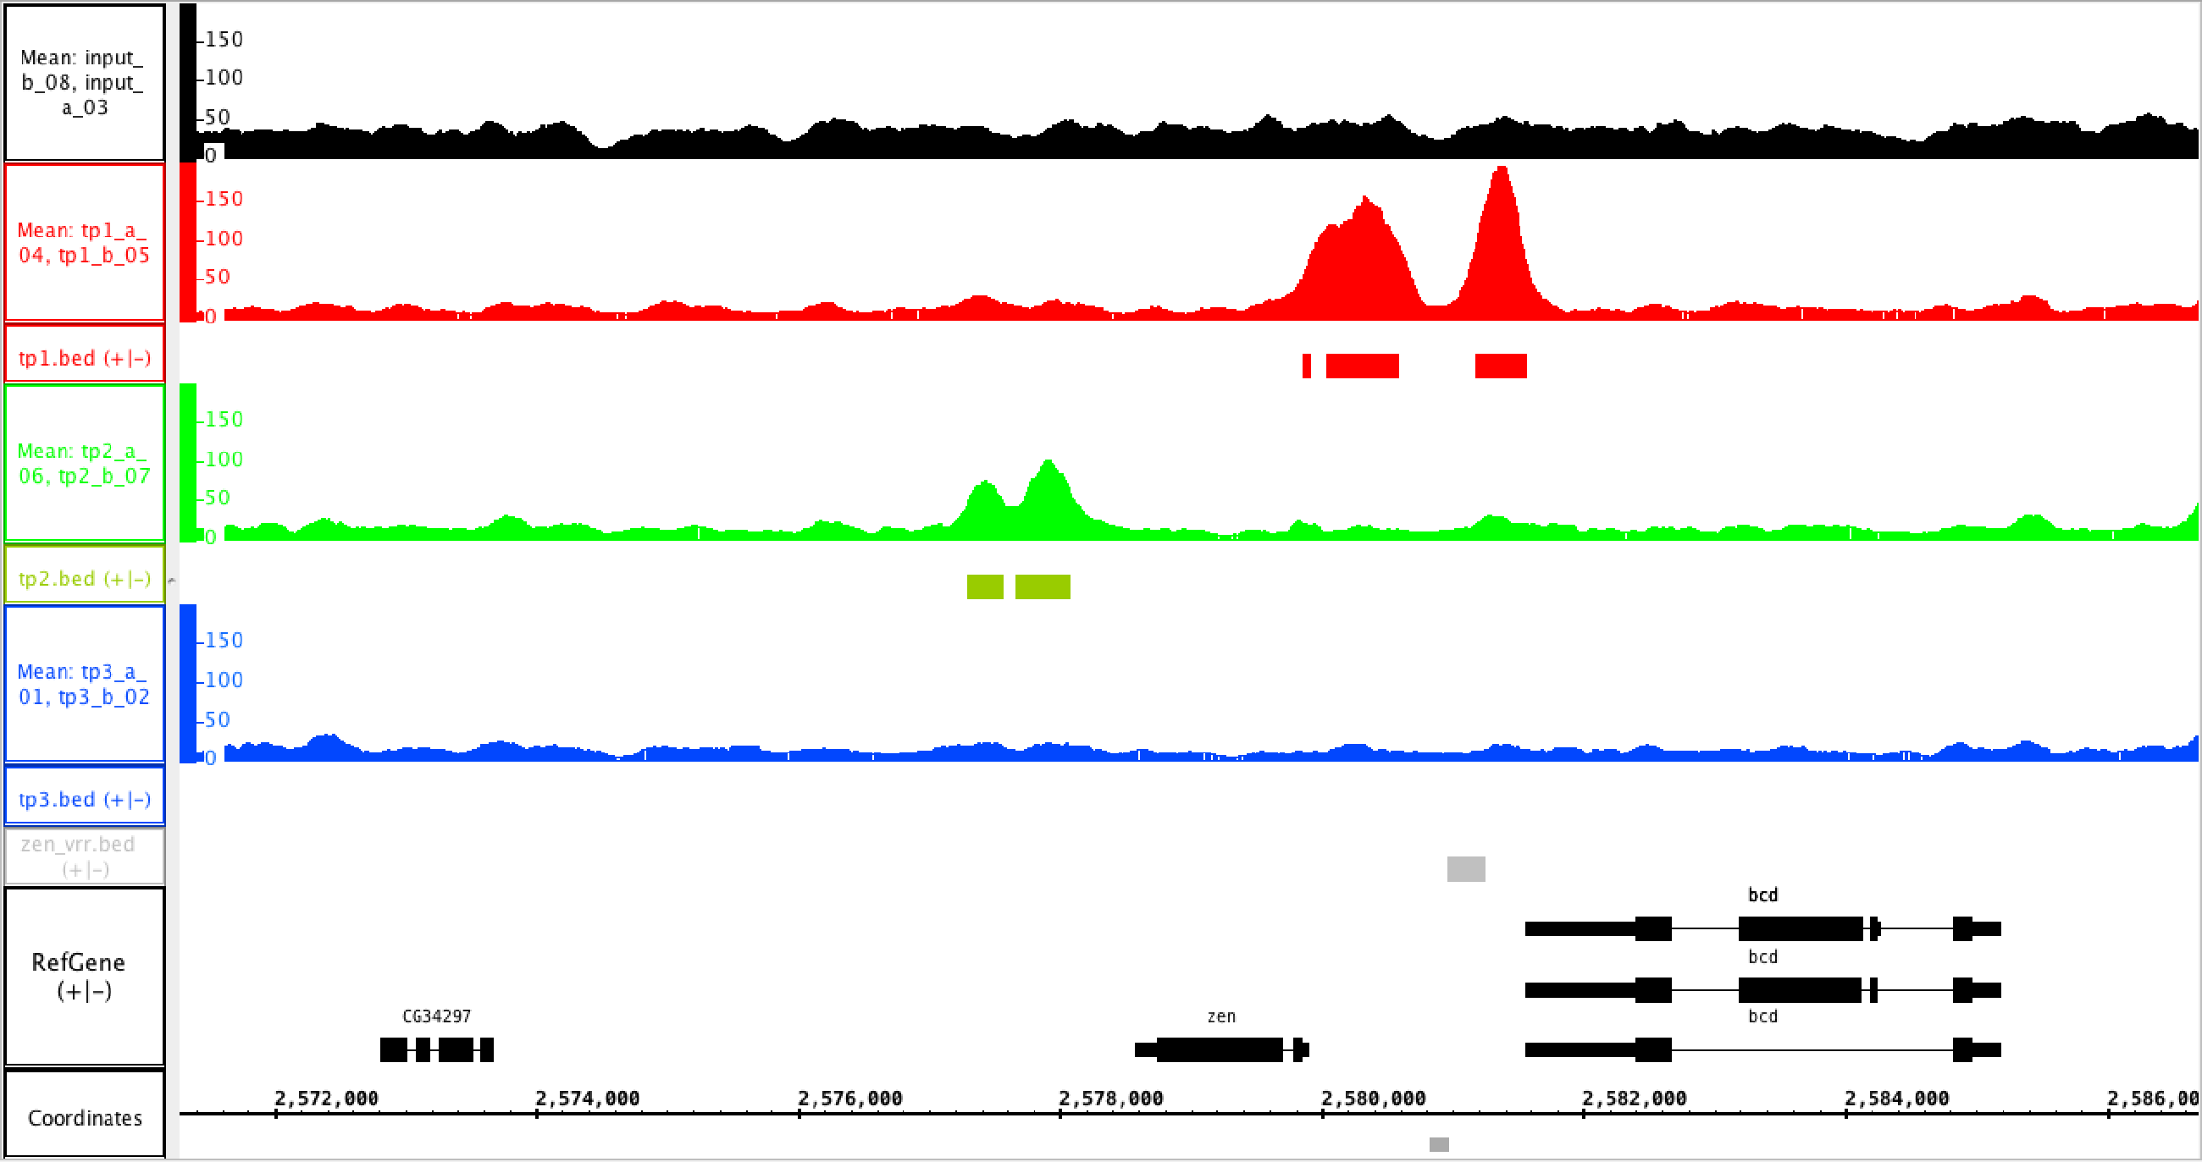
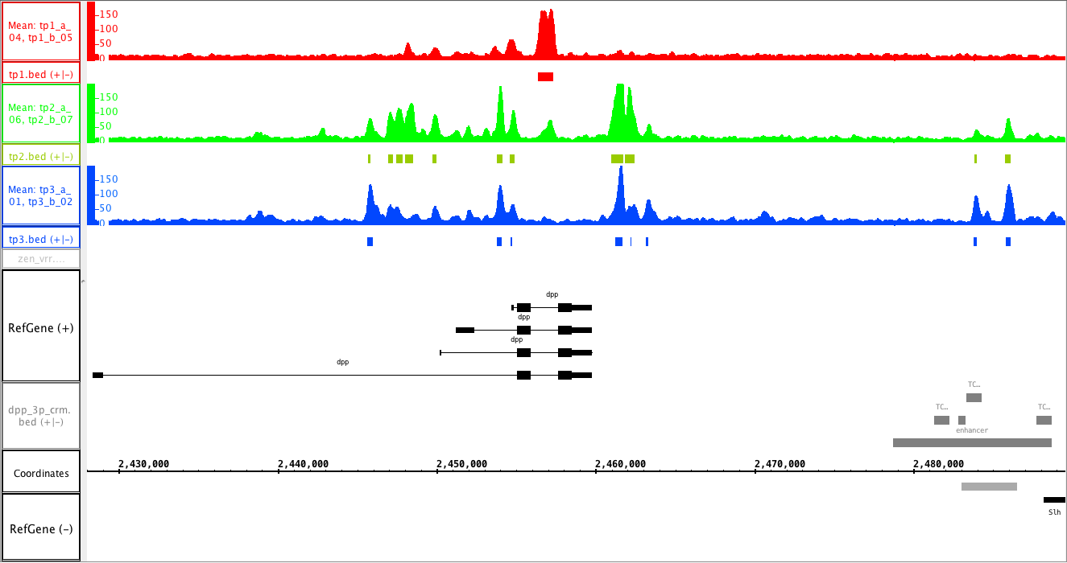
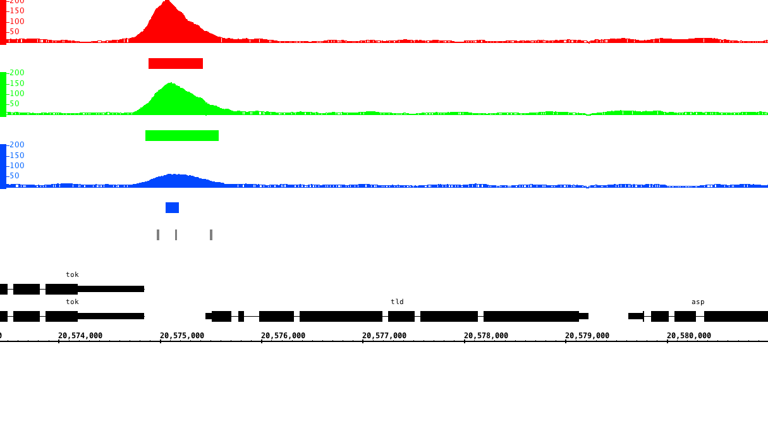
A
1.5 – 4 hr
4 – 6.5 hr
6.5 – 9 hr
VRR
B
1.5 – 4 hr
4 – 6.5 hr
6.5 – 9 hr
C
1.5 – 4 hr
4 – 6.5 hr
6.5 – 9 hr
Dorsal binding sites

Slide 5
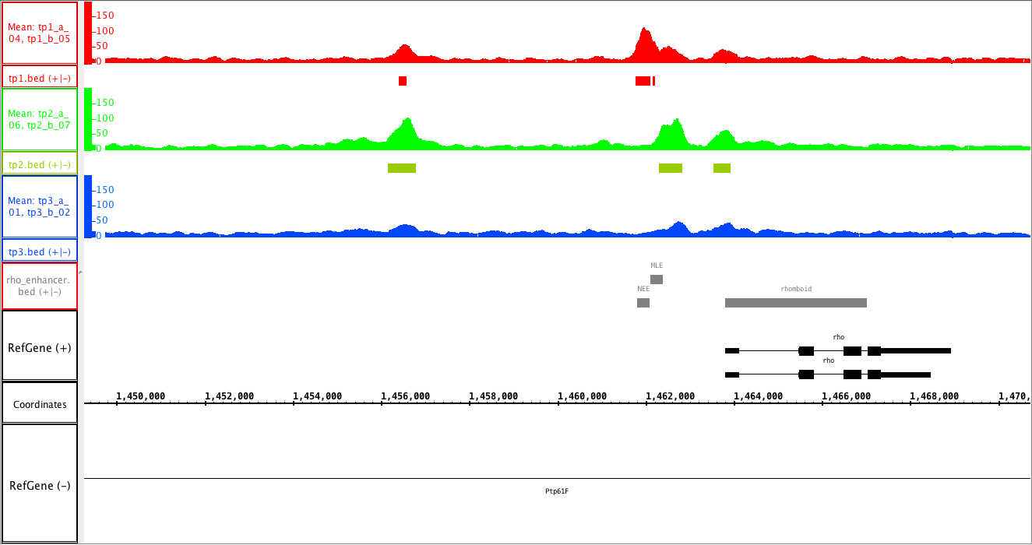
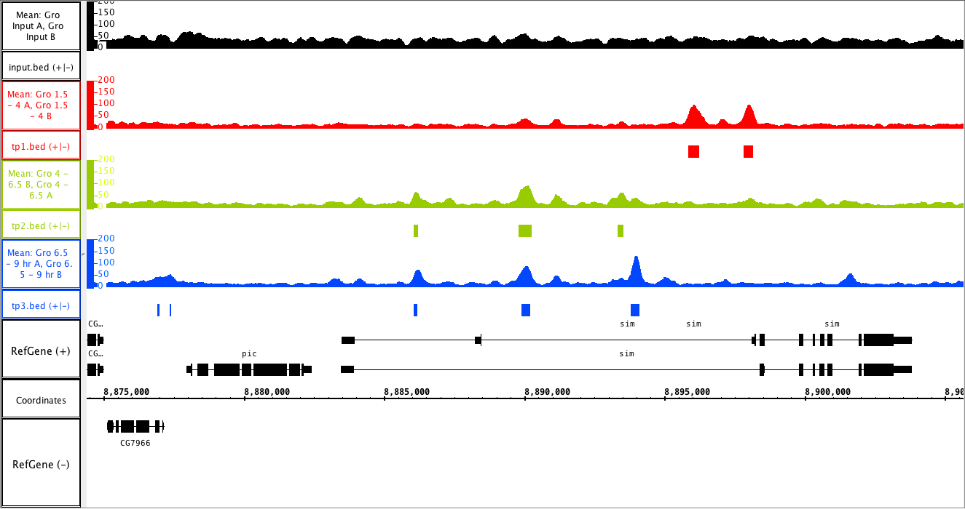
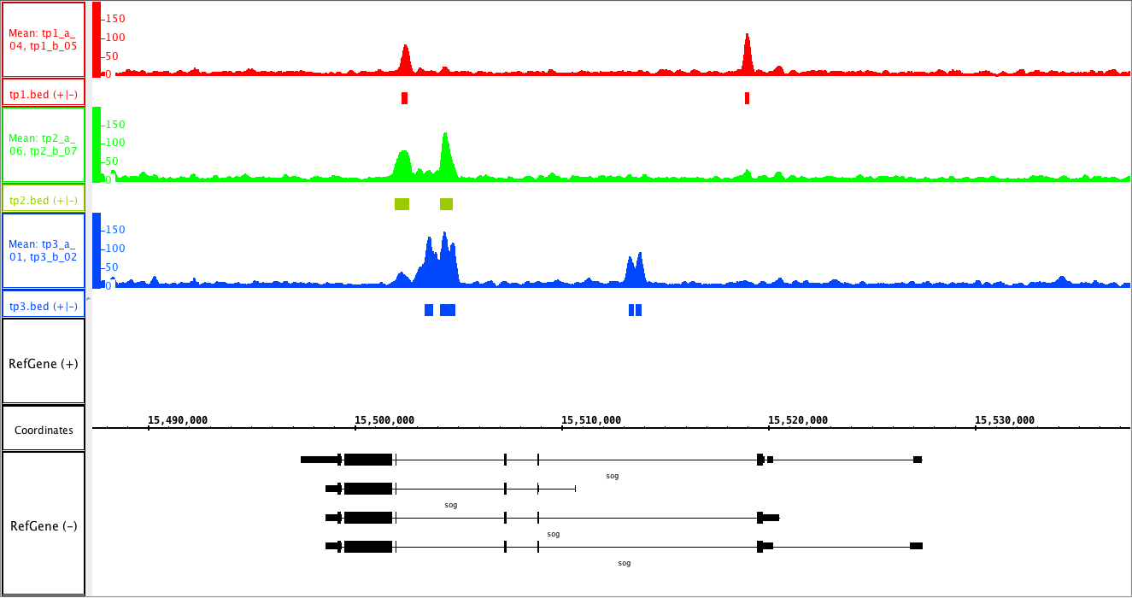
A
1.5 – 4 hr
4 – 6.5 hr
6.5 – 9 hr
NEE
MLE
B
1.5 – 4 hr
4 – 6.5 hr
6.5 – 9 hr
C
1.5 – 4 hr
4 – 6.5 hr
6.5 – 9 hr

Slide 6
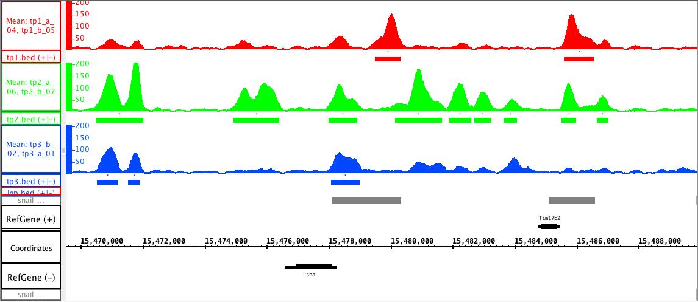
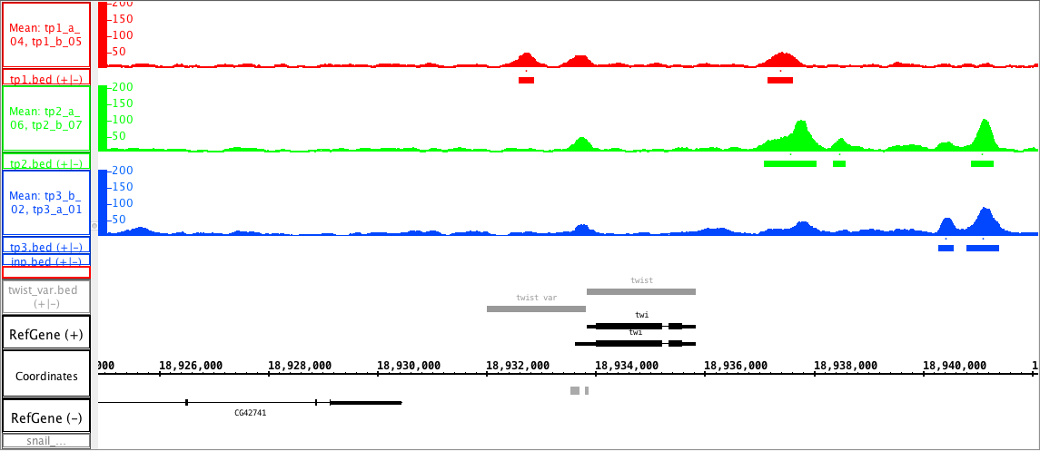
A
1.5 – 4 hr
4 – 6.5 hr
6.5 – 9 hr
primary
shadow
B
1.5 – 4 hr
4 – 6.5 hr
6.5 – 9 hr
VAR

Slide 7
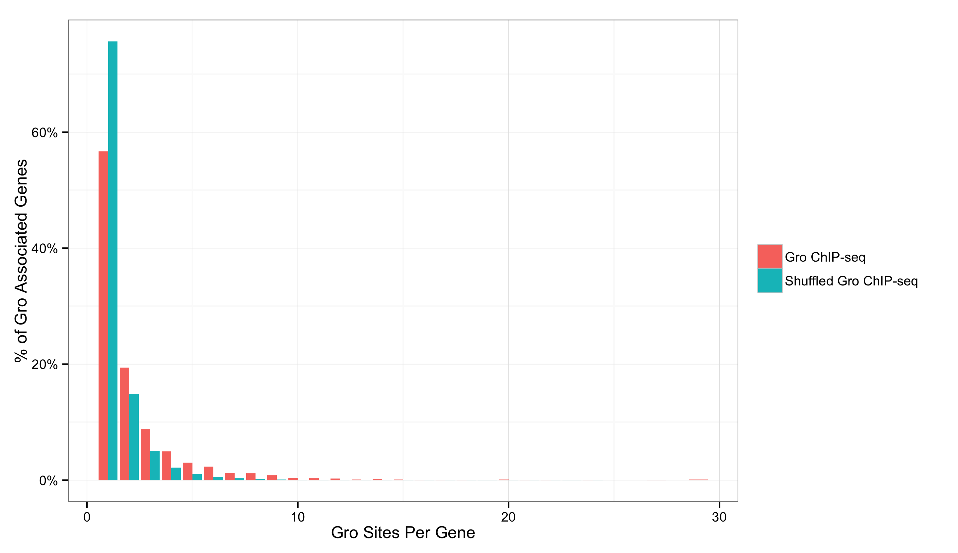
A
B
1
2
3
4
5

Slide 8
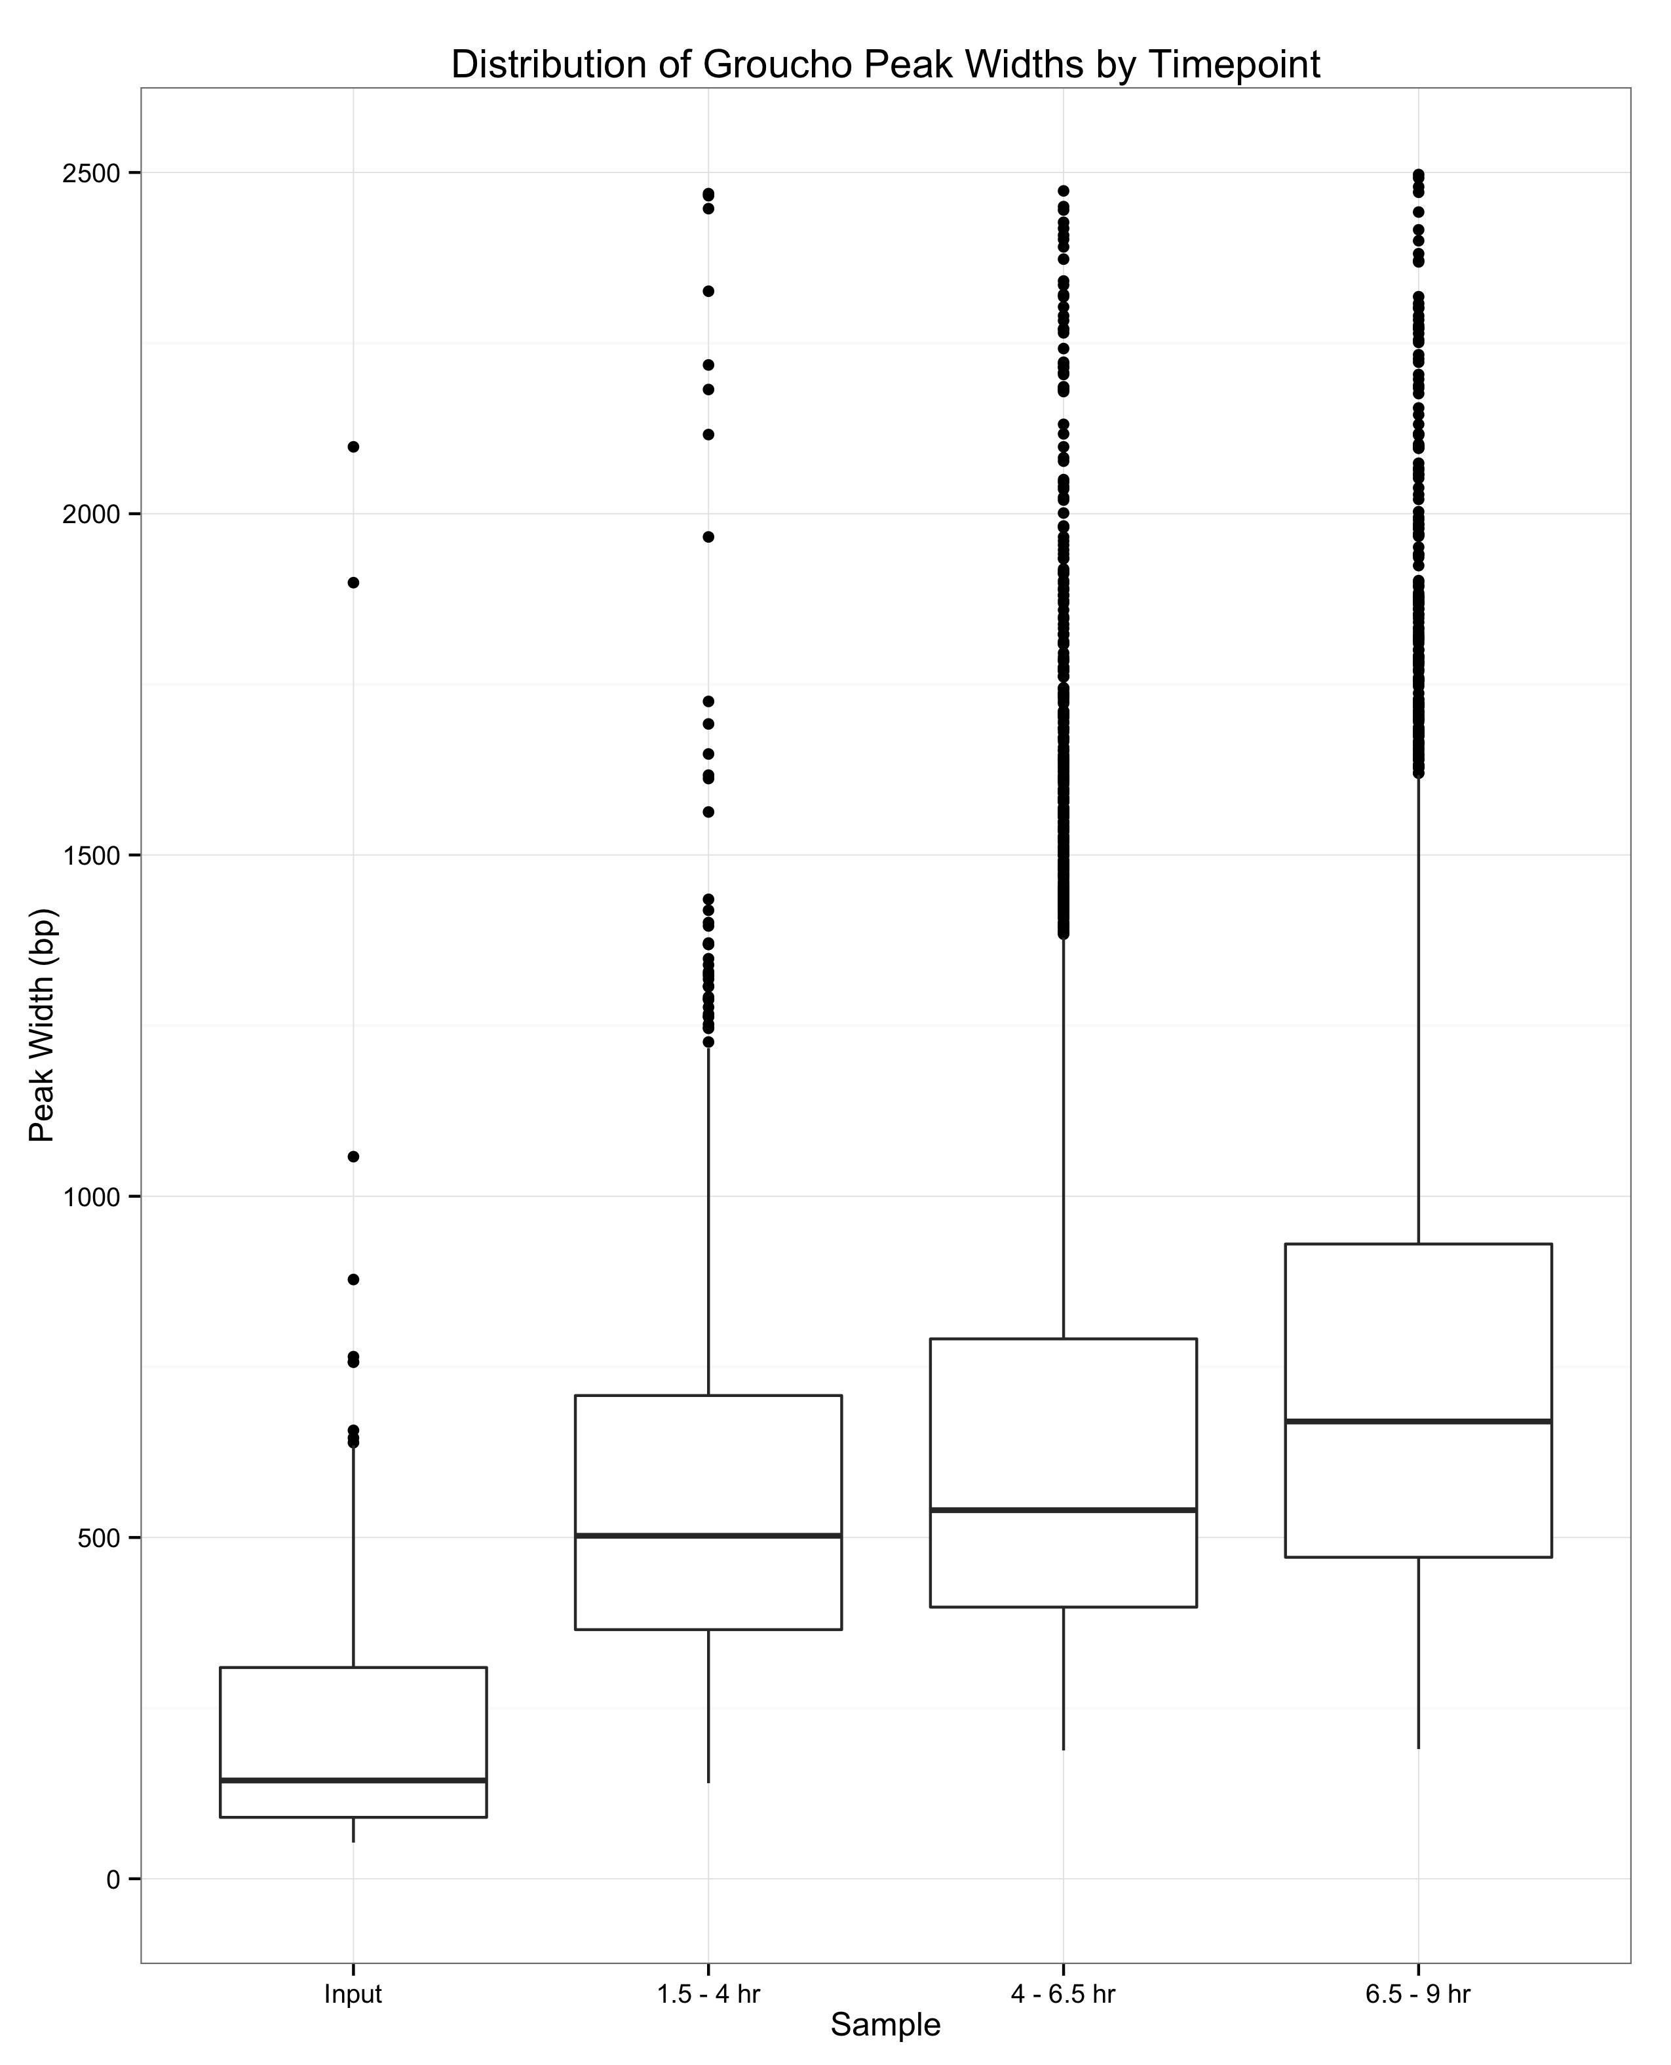

Slide 9
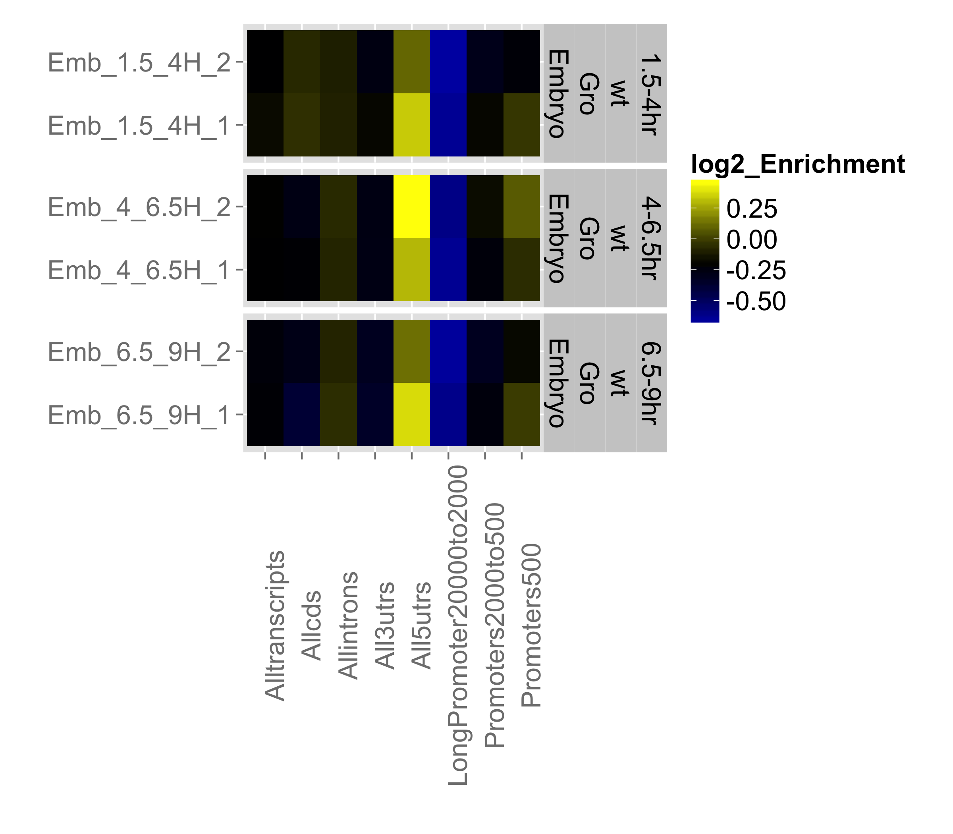
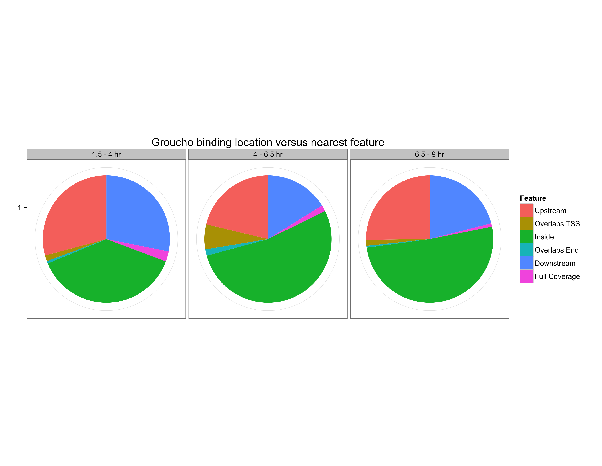
A
Upstream
(bp)
500 to -50
2,000 to 500
20,000 to 2,000
5’ UTR
3’ UTR
Intron
CDS
Transcript
B

Slide 10
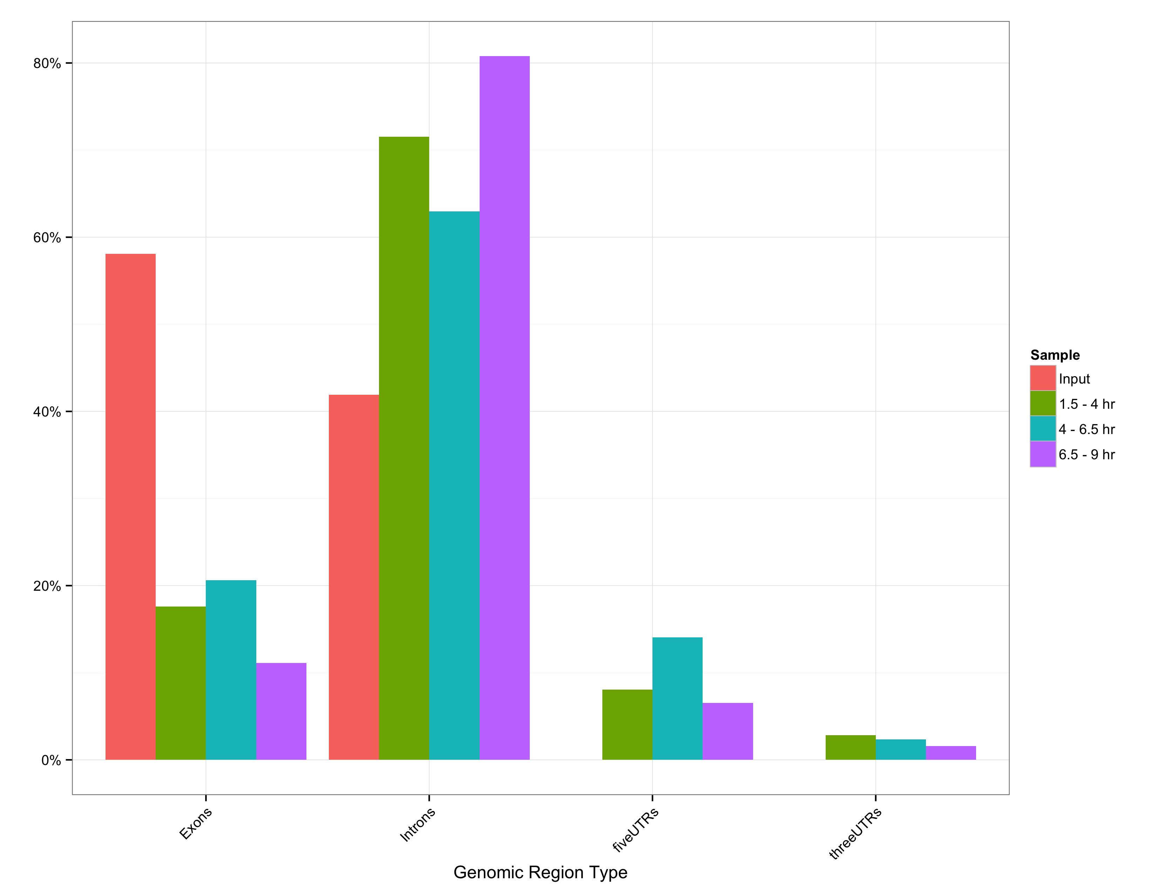
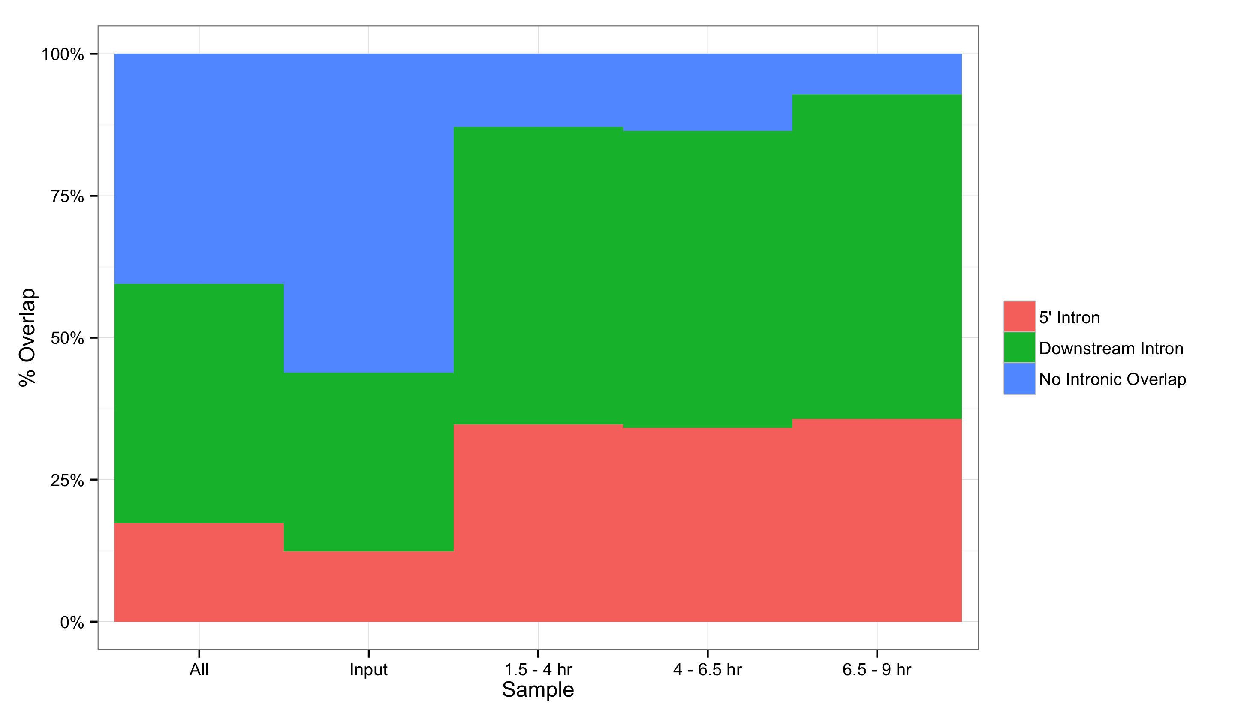
A
B

Slide 11
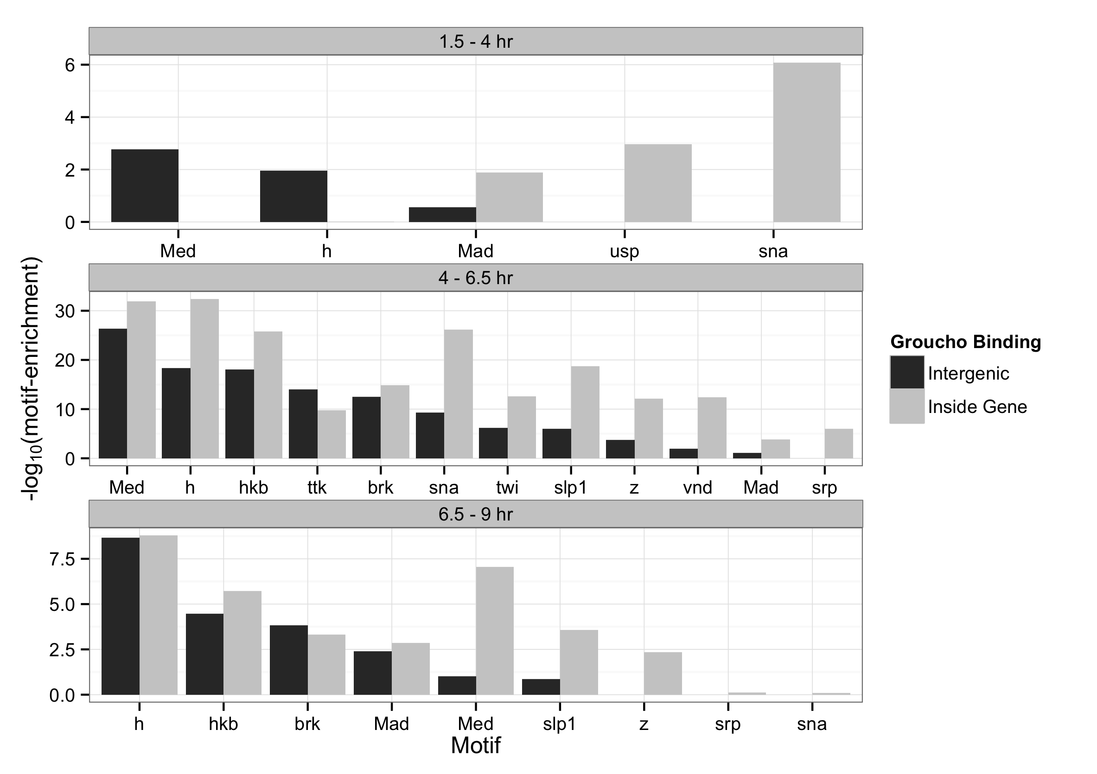

Slide 12
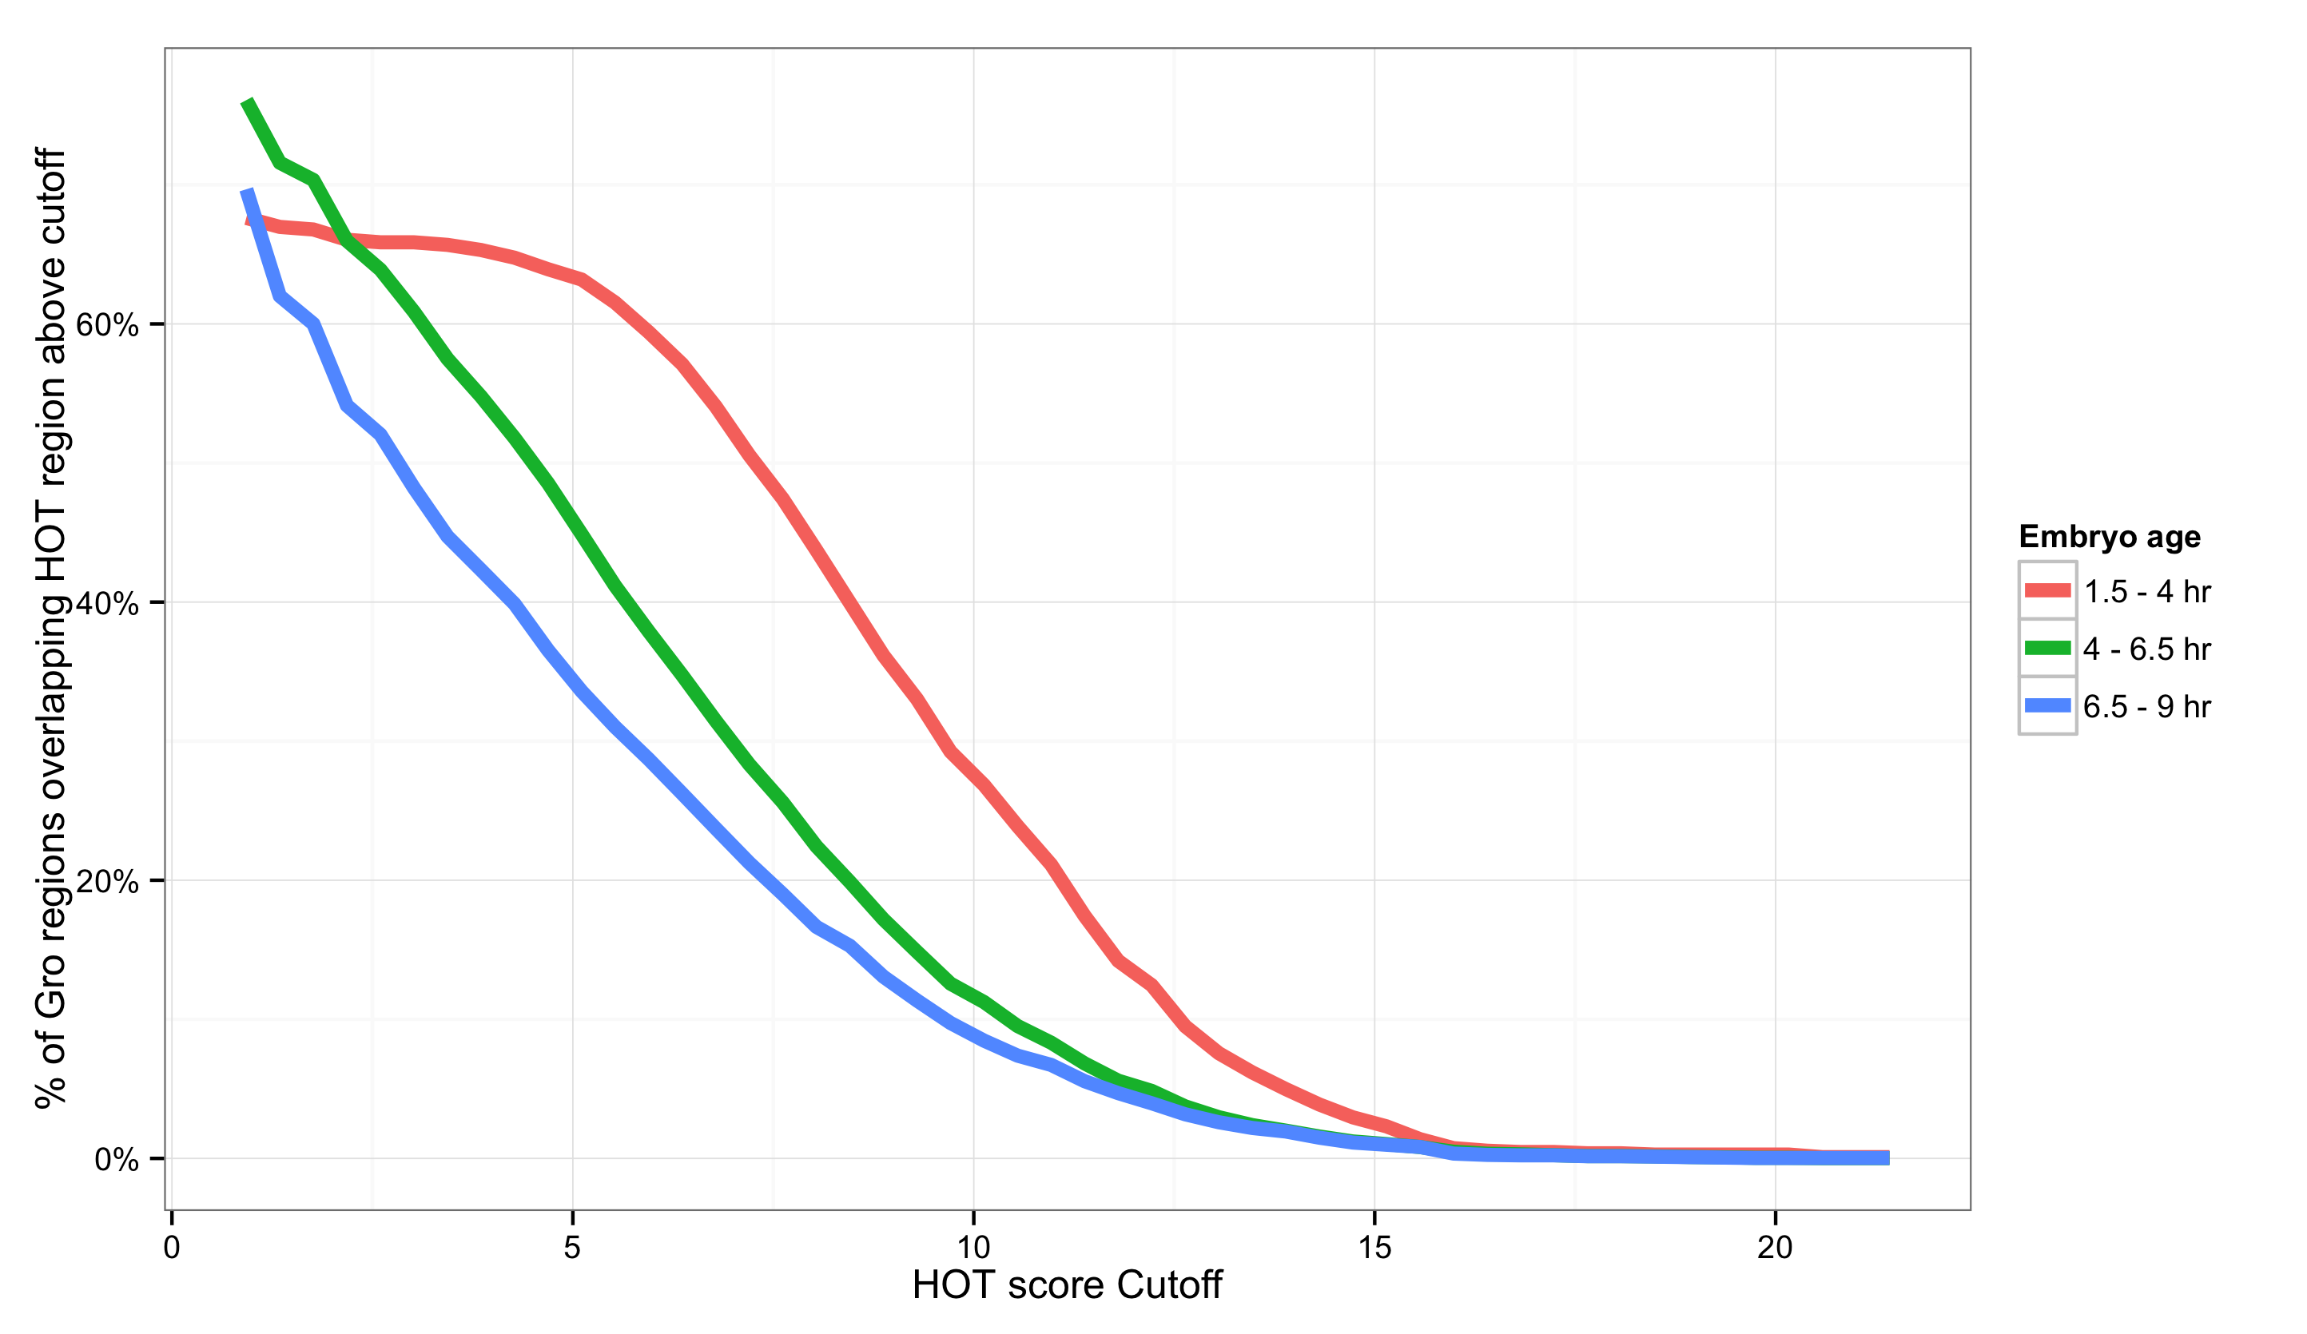
<
<
<
<

Slide 13
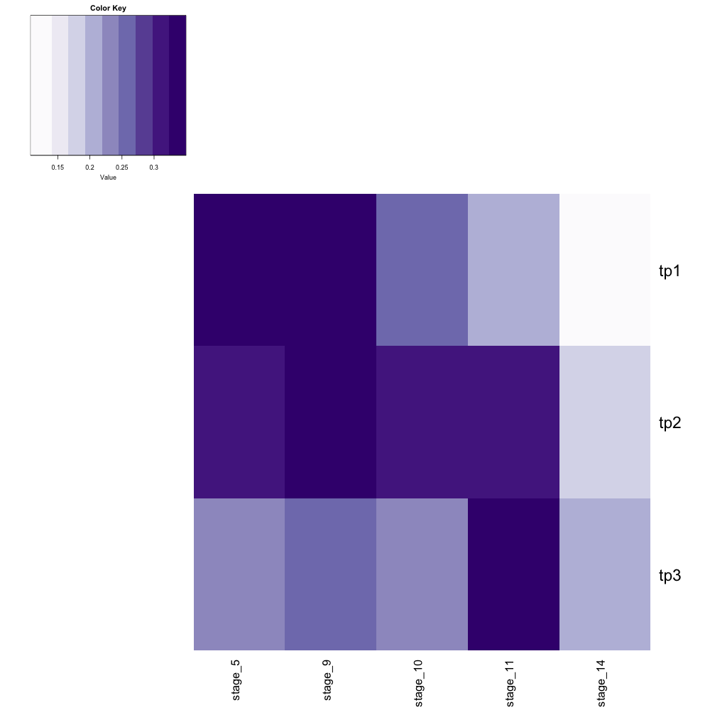

30%
25%
20%
15%
Chromatin accessibility (DNase-seq)
Stage 5
Stage 9
Stage 10
Stage 11
Stage 14
1.5 – 4 hr
Groucho ChIP-seq
4 – 6.5 hr
6.5 – 9 hr
1.5 – 4 hr
4 – 6.5 hr
6.5 – 9 hr

Slide 14
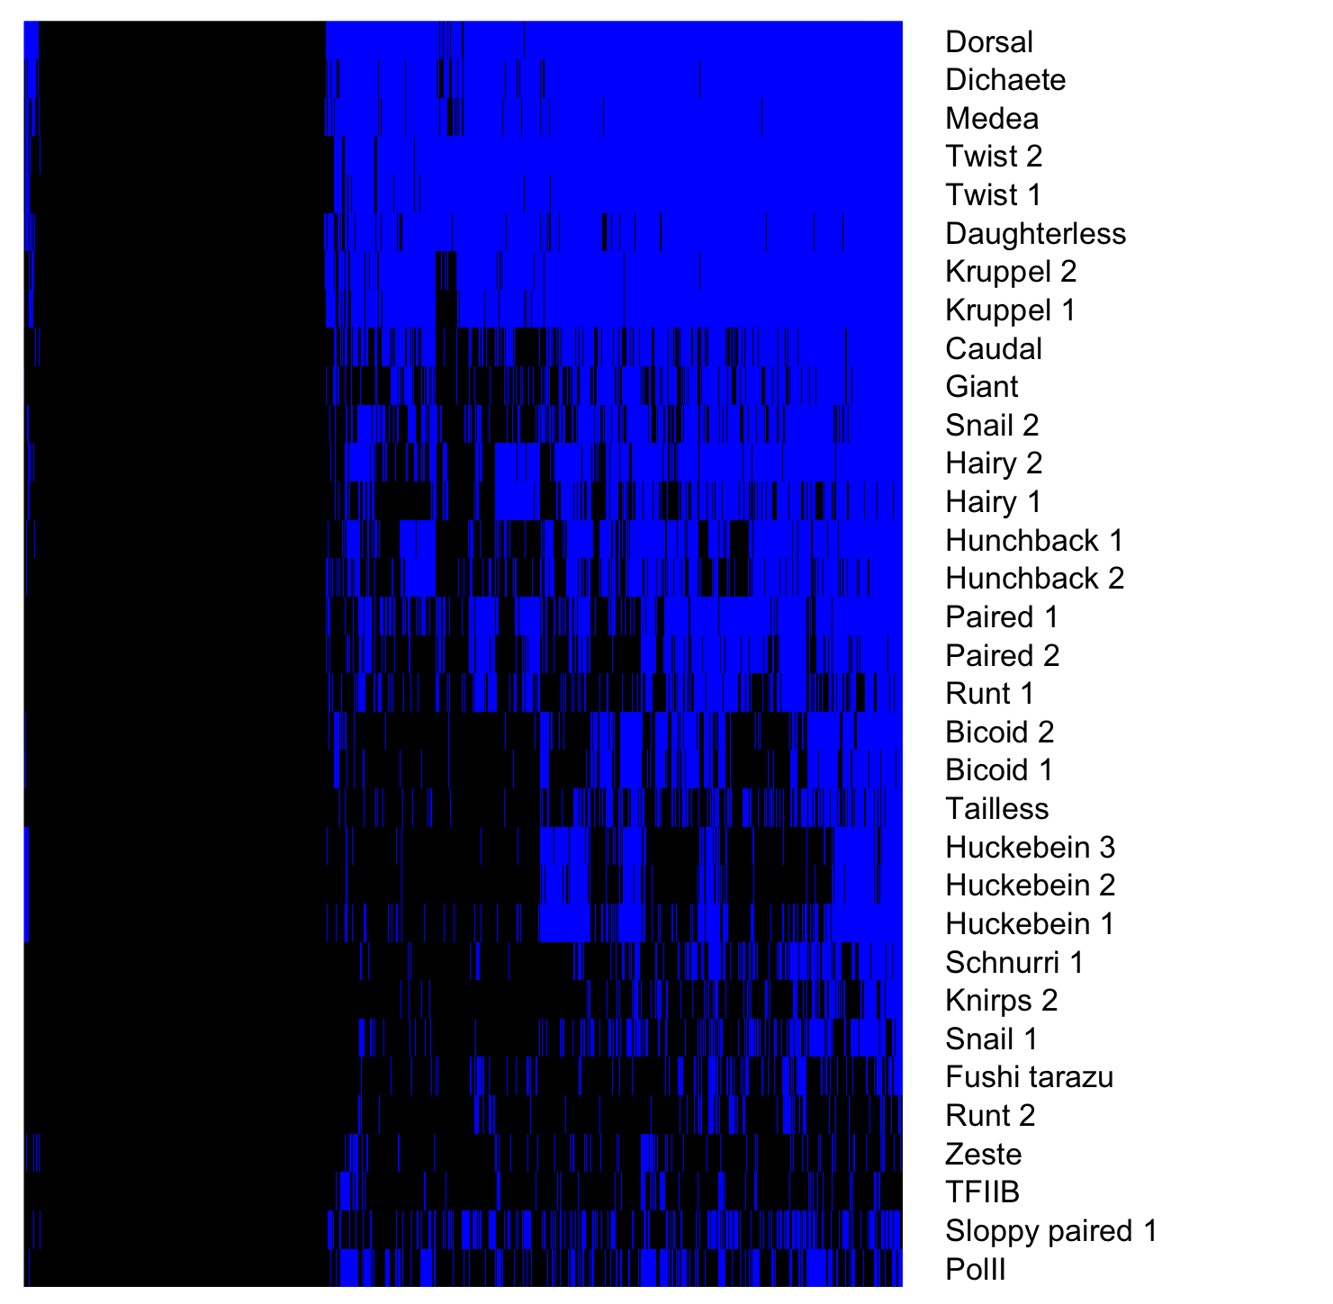
Gro binding sites, 1.5 – 4 hr embryos
Factor occupancy

Slide 15
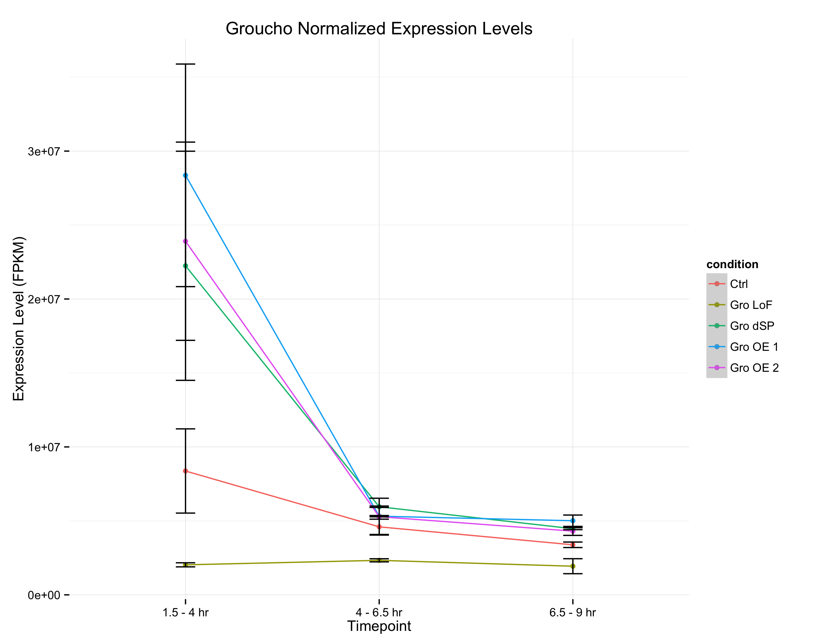
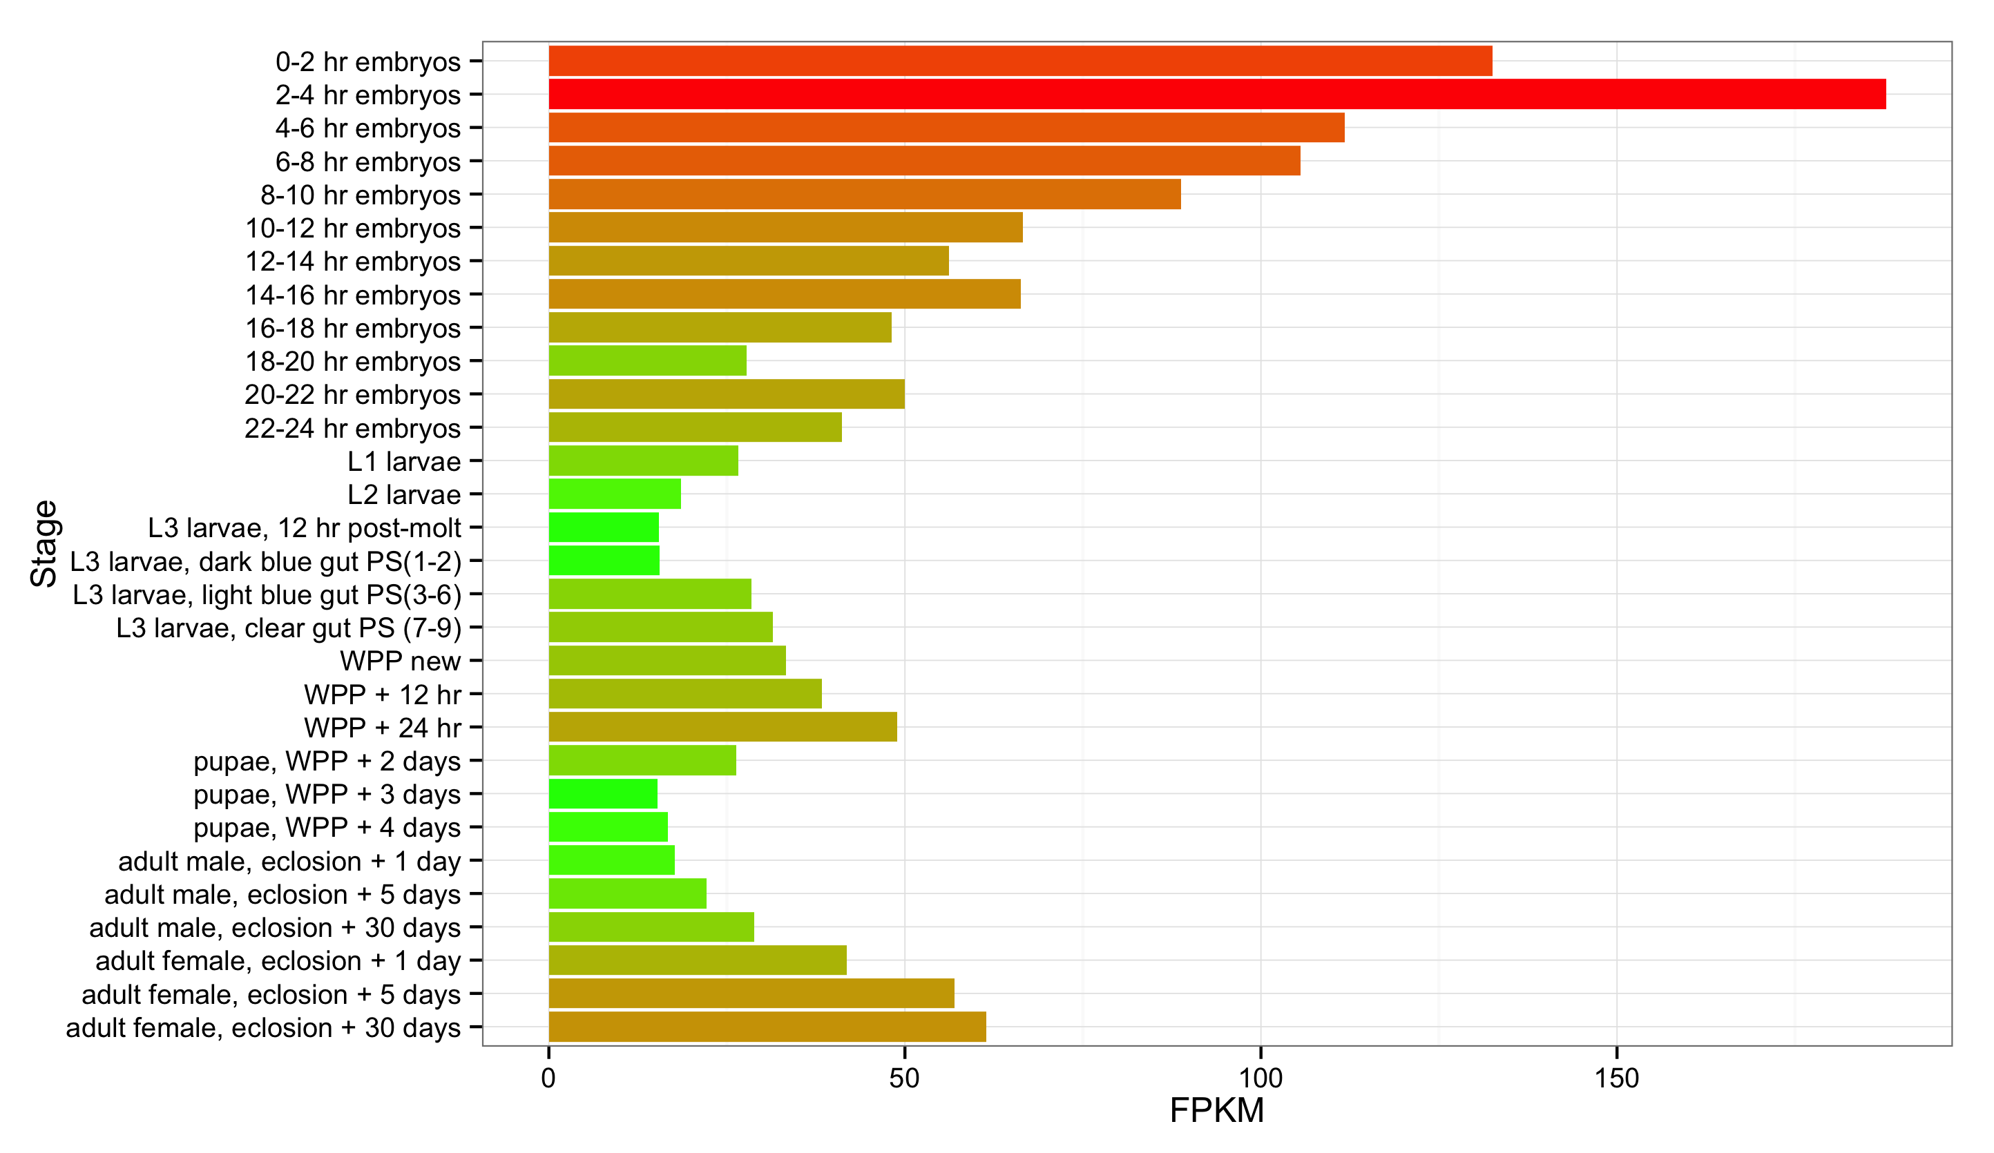
A
wt
Gro^{MB36}
GroΔSP
Gro overexpression 1
Gro Overexpression 2
Groucho transcript abundance
modENCODE Developmental Transcriptome Project
B

Slide 17
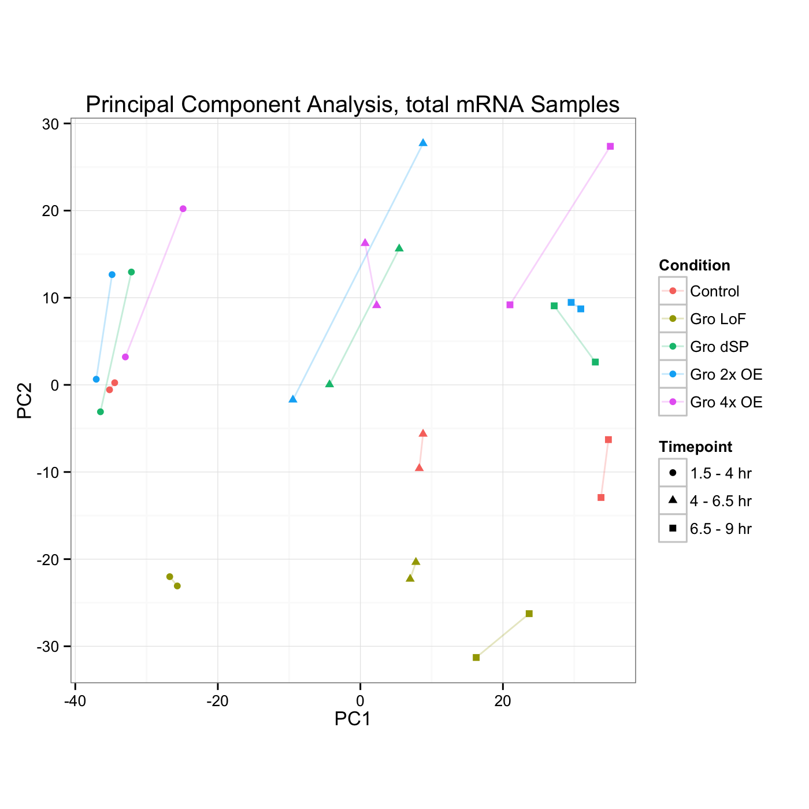
Gro Dosage
Developmental Stage

Slide 18
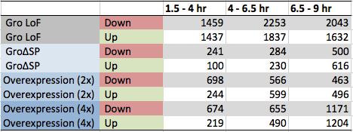
A
B

Slide 19
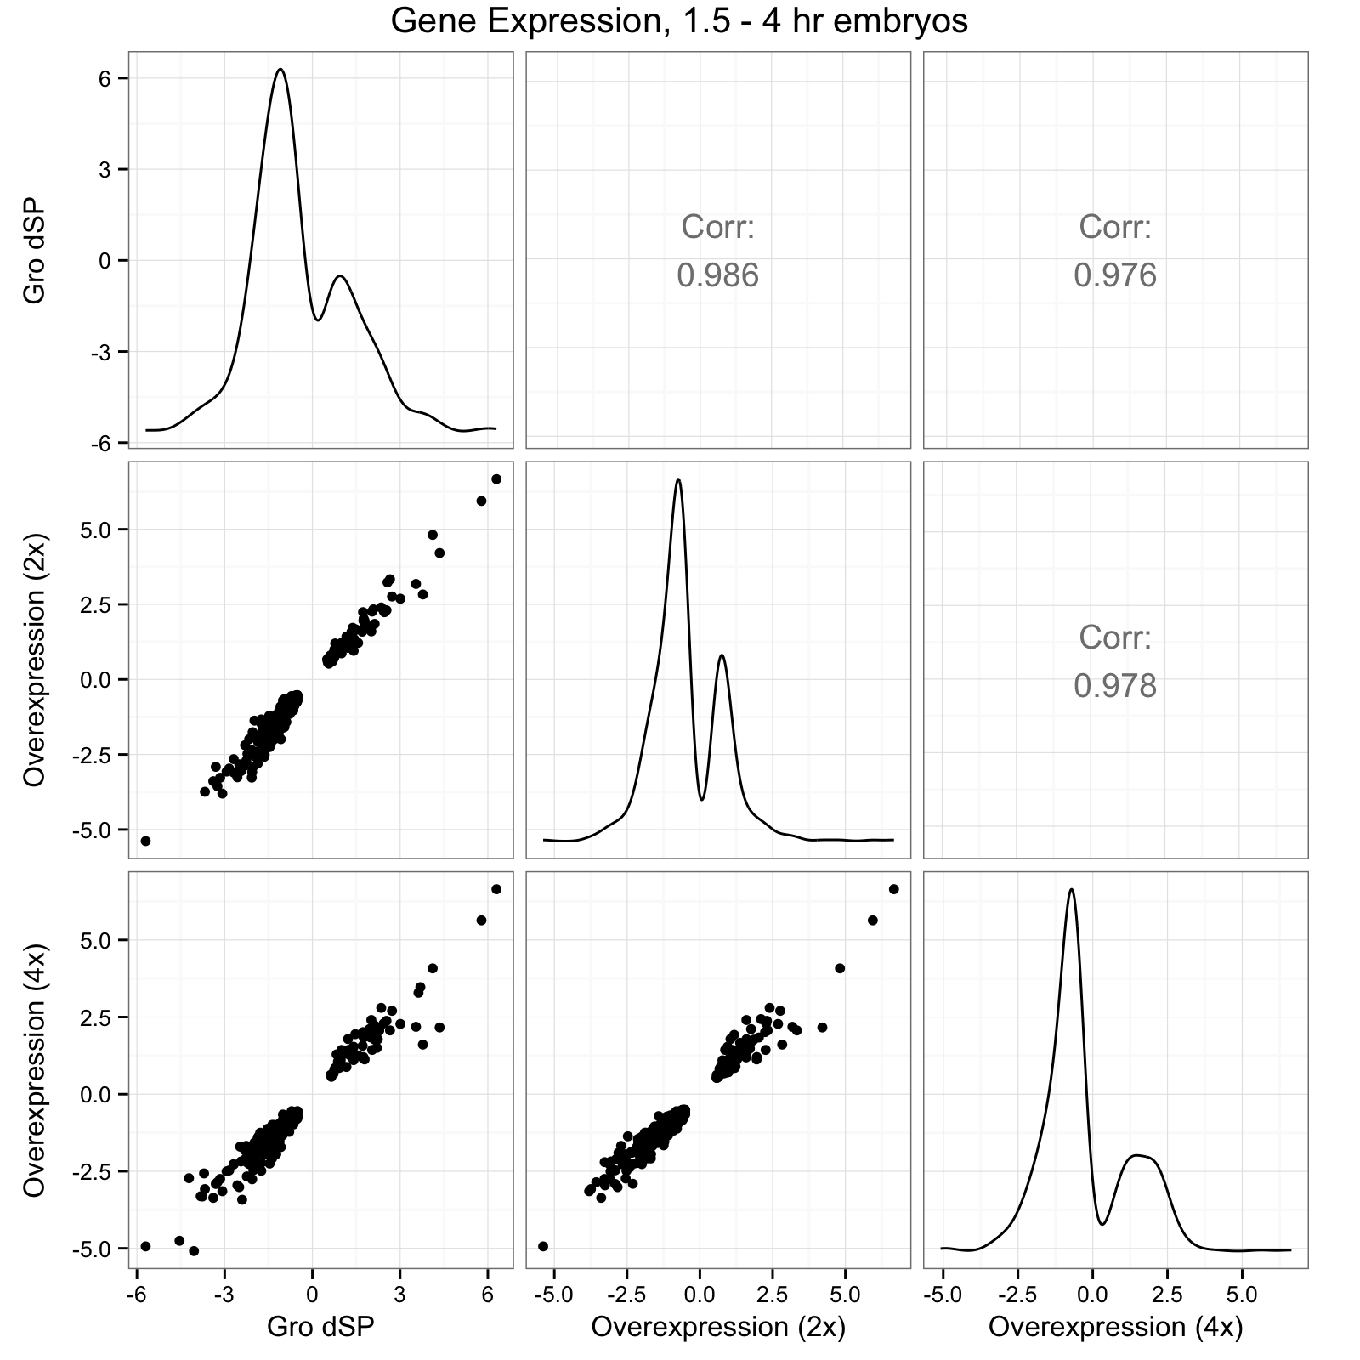
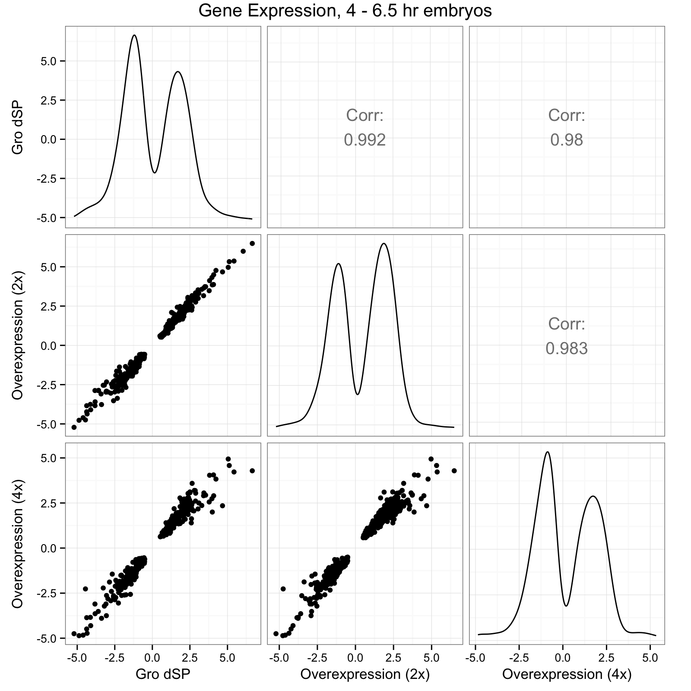
A
B

Slide 20
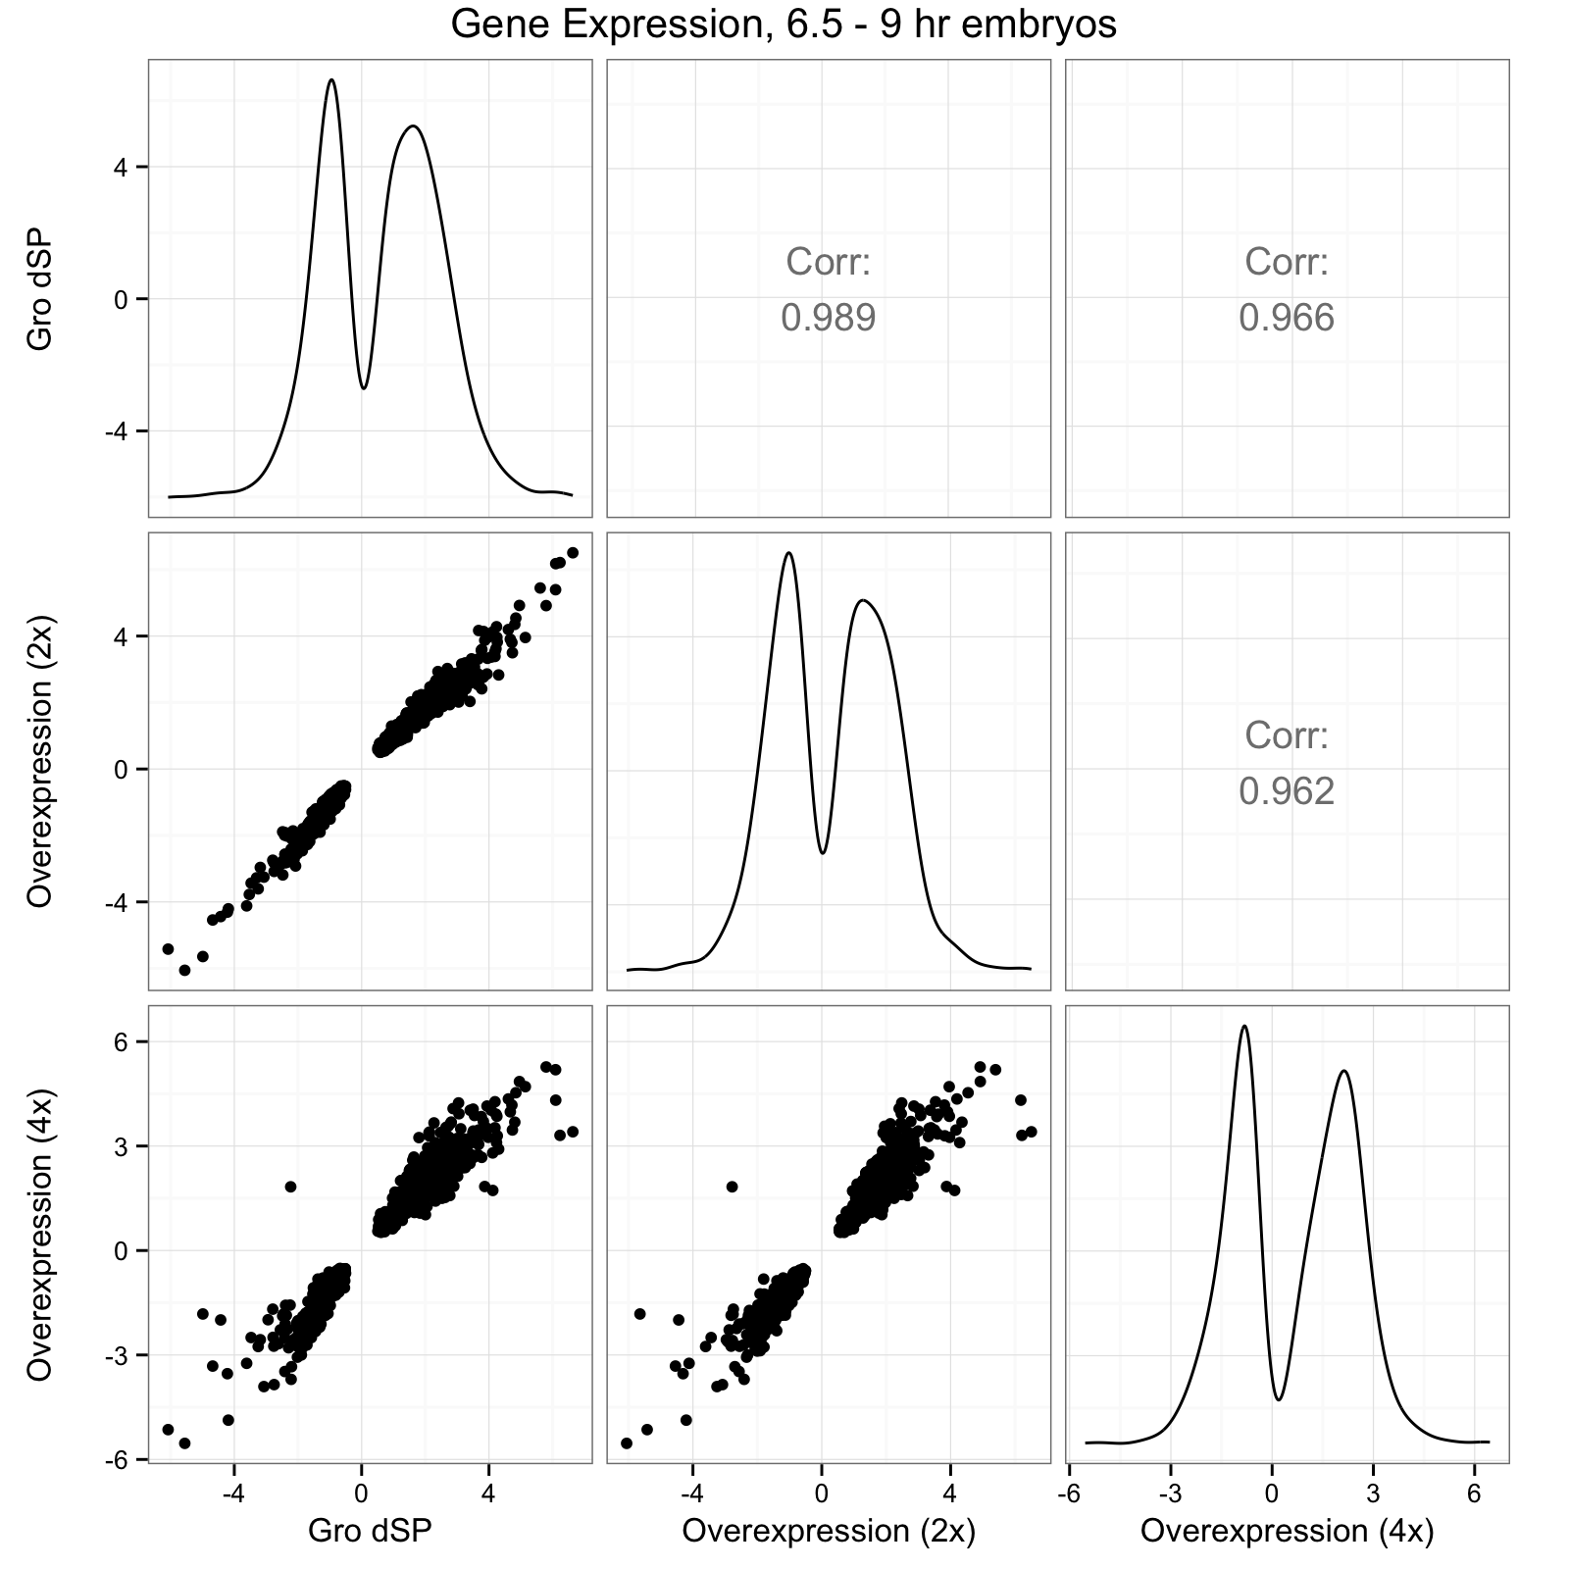
C

Slide 21
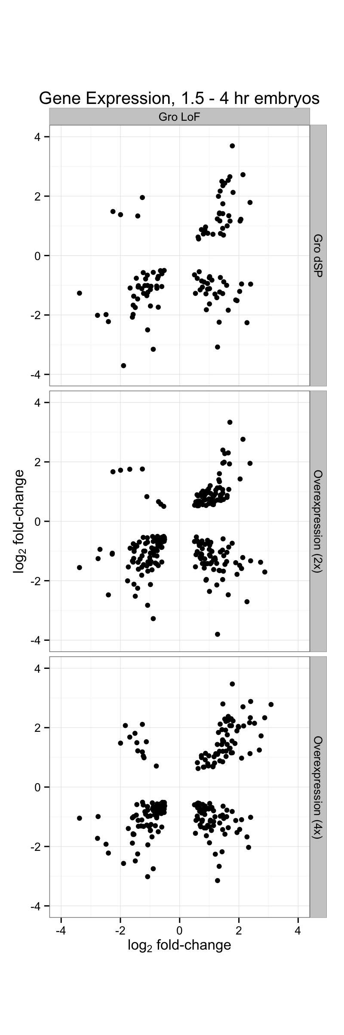
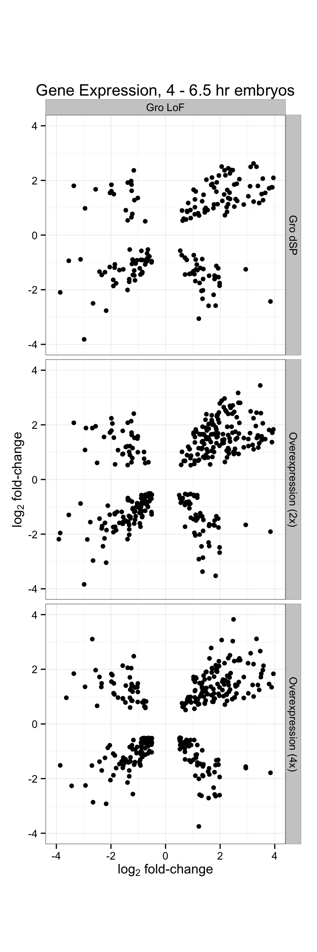
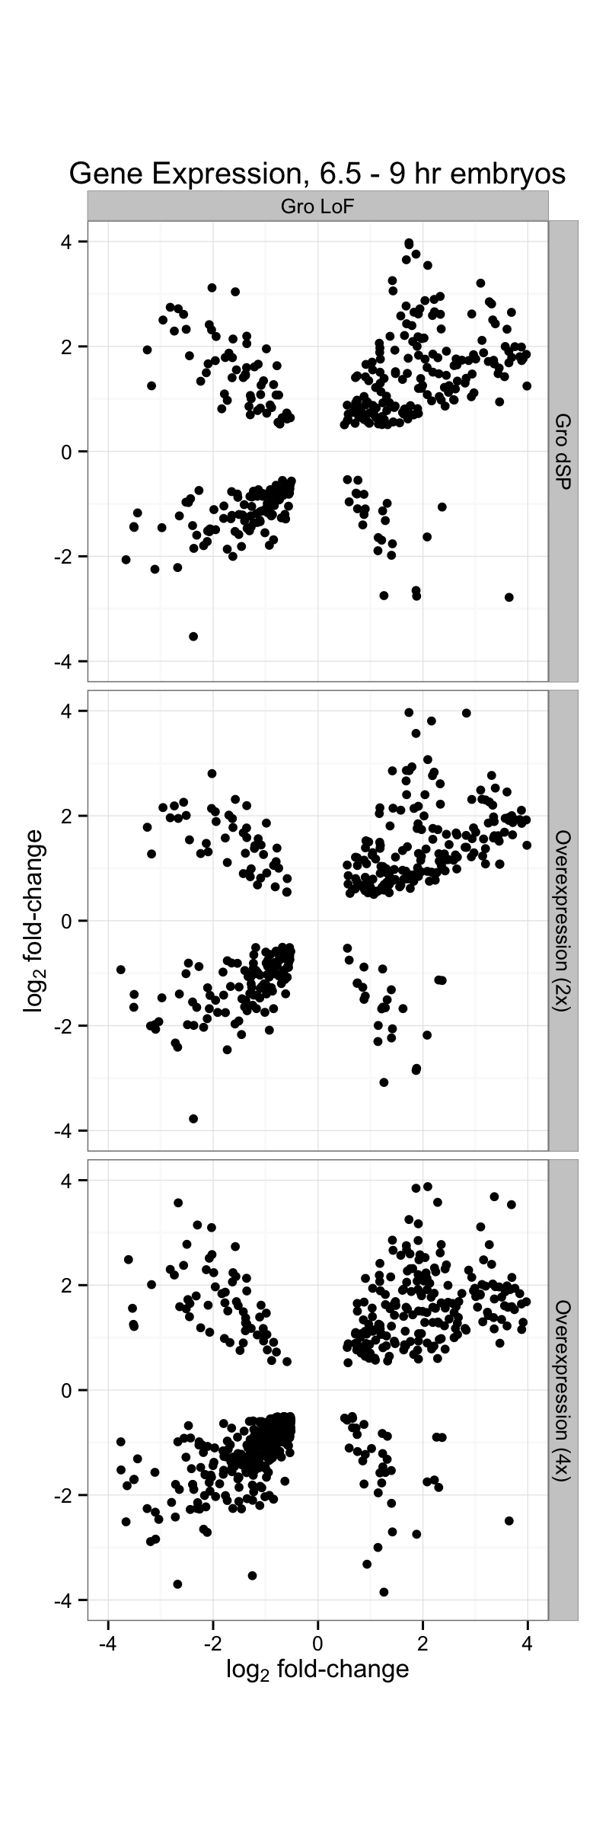

Slide 22
Gro loss-of-function
vs.
2x Gro Overexpression
Gro loss-of-function
vs.
4x Gro Overexpression

Slide 23
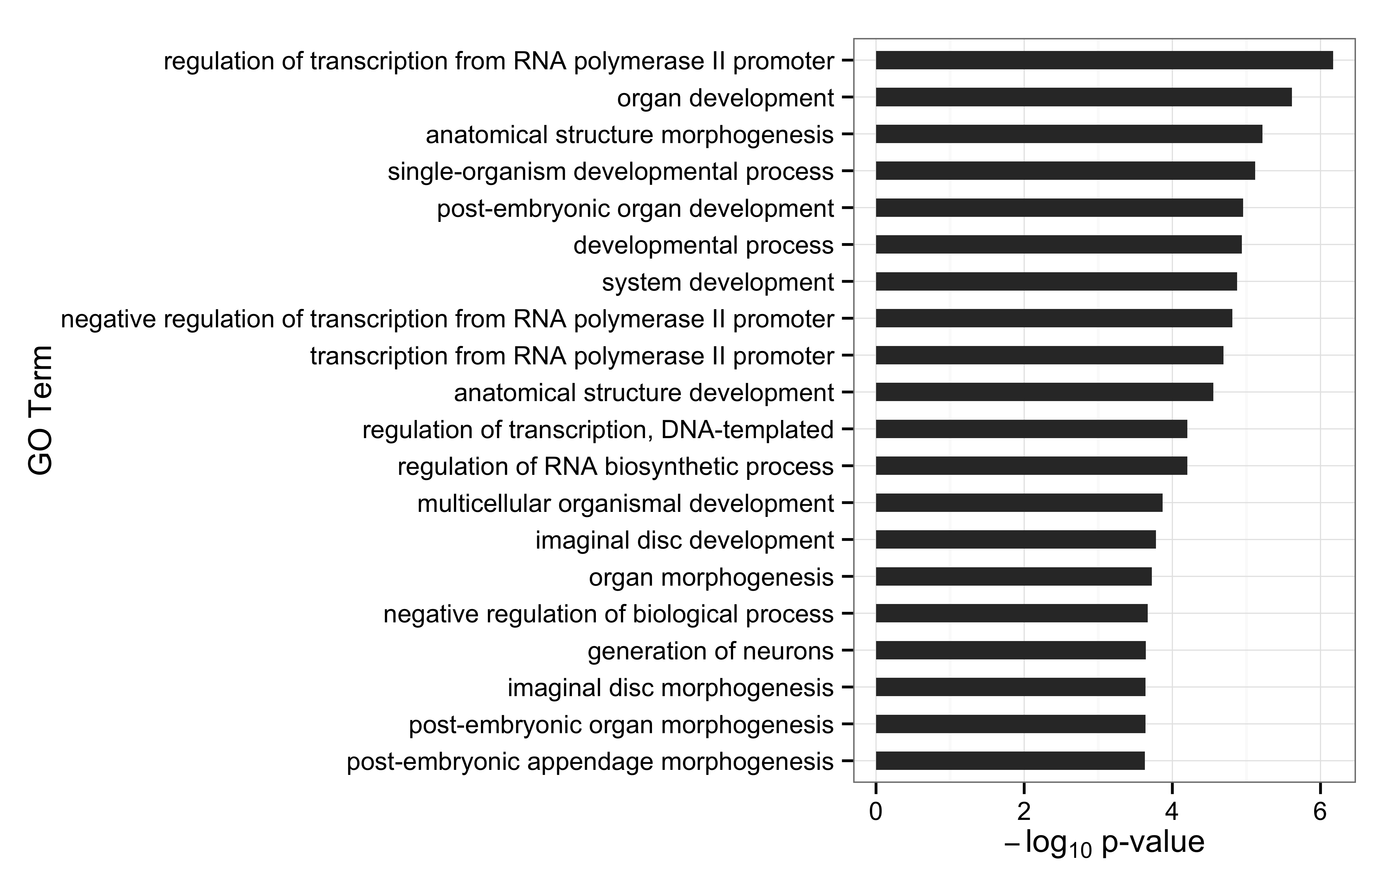

Slide 24
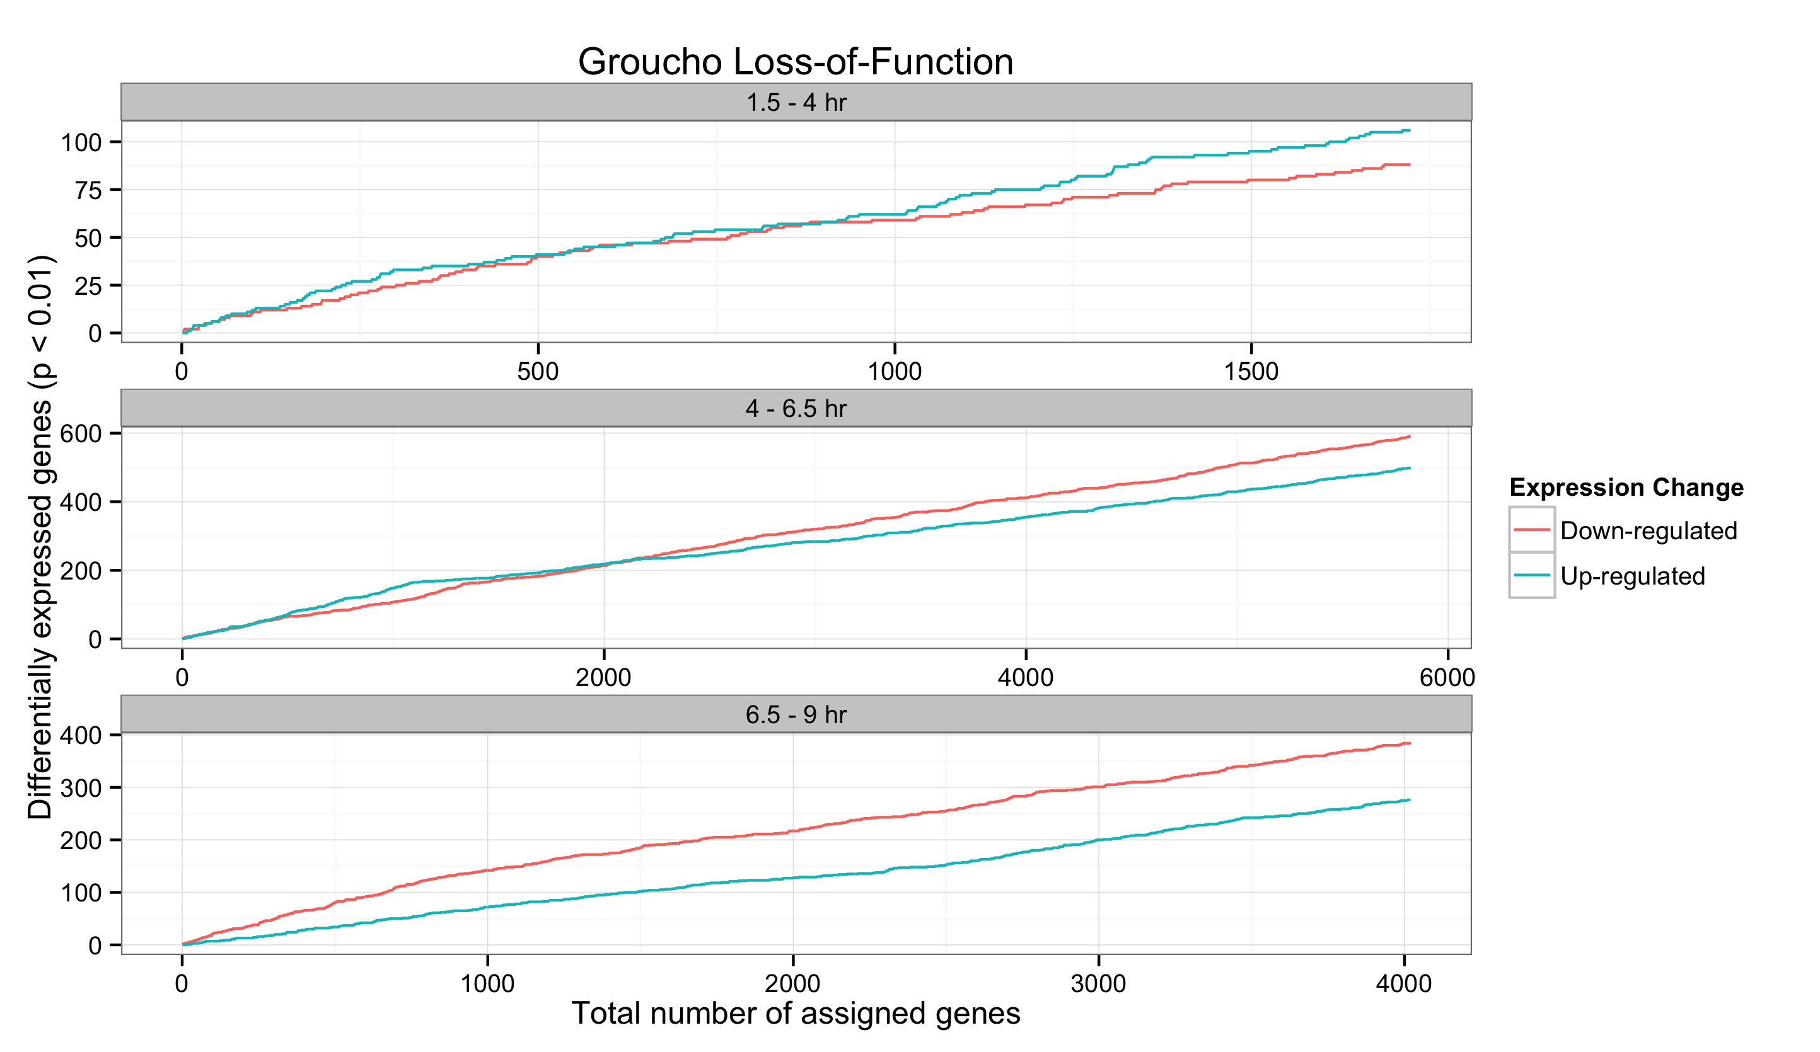
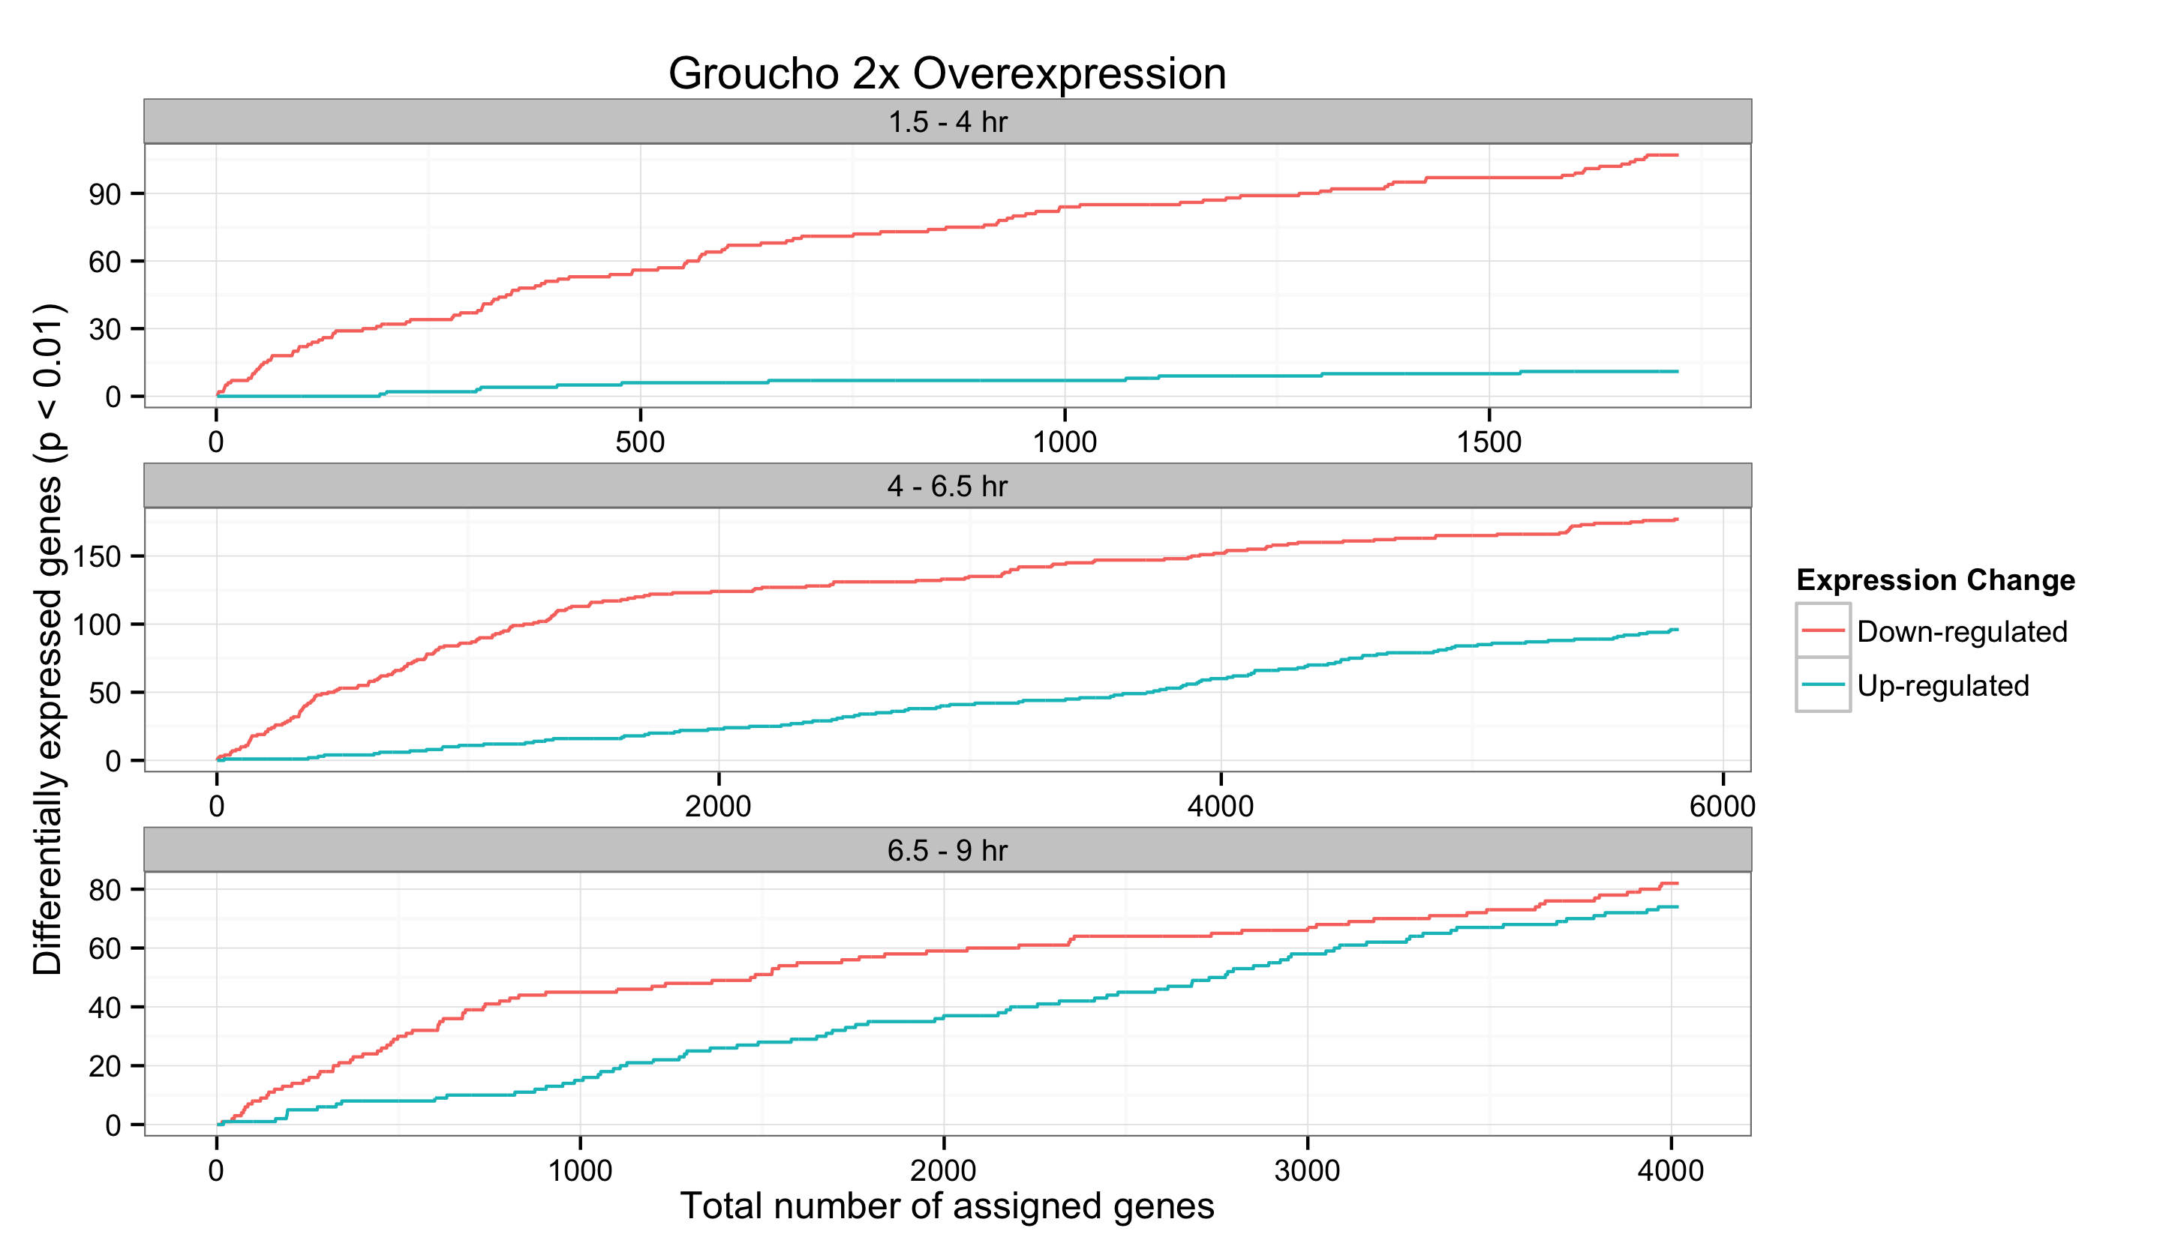
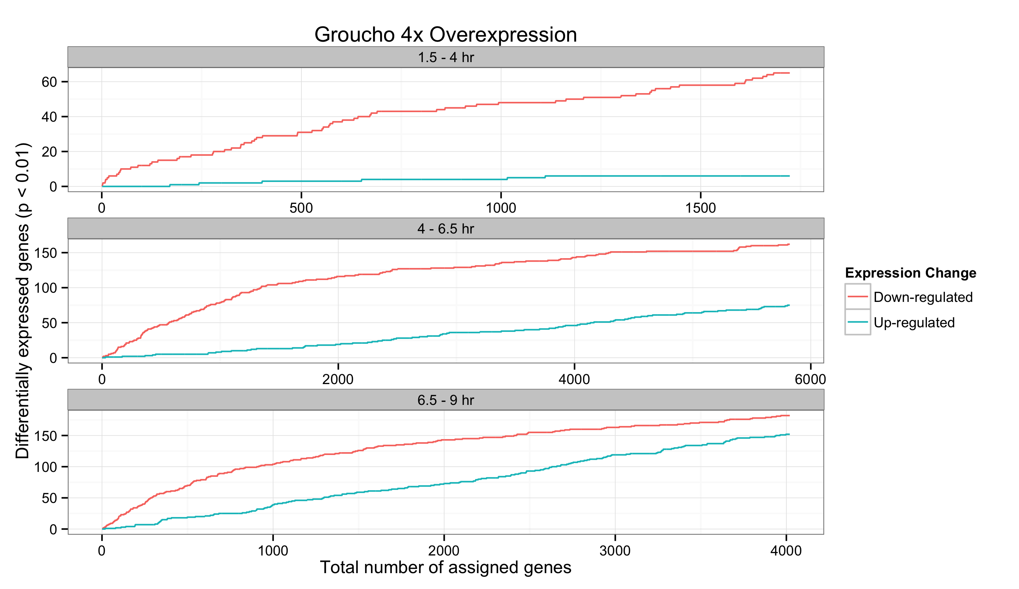
A
B
C

Slide 25
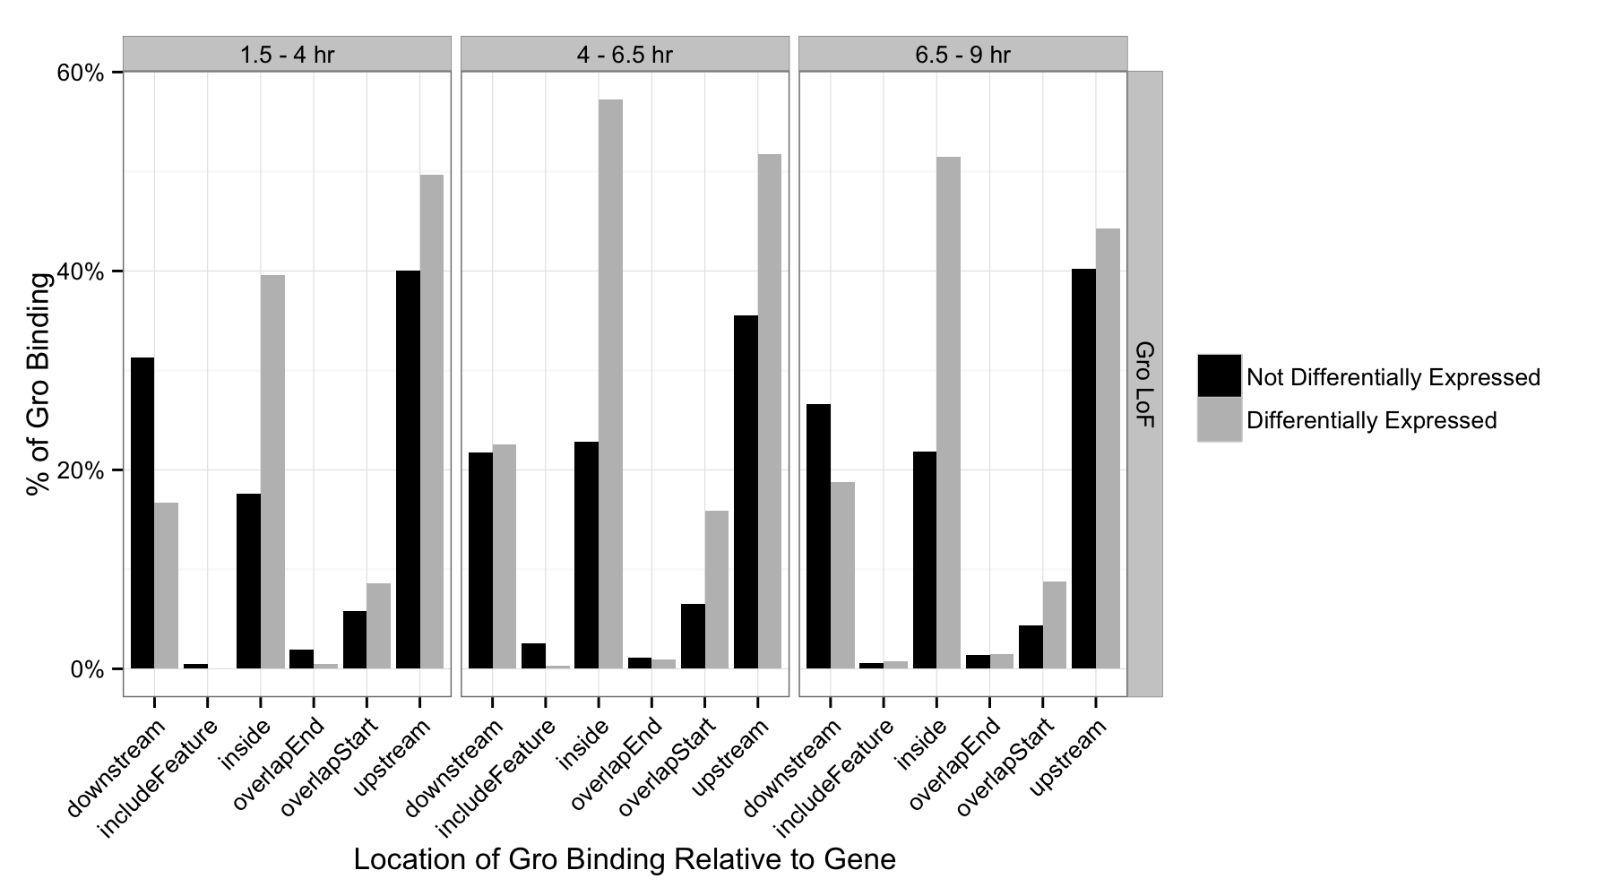
Percentage of genes with internal Groucho binding

Slide 26
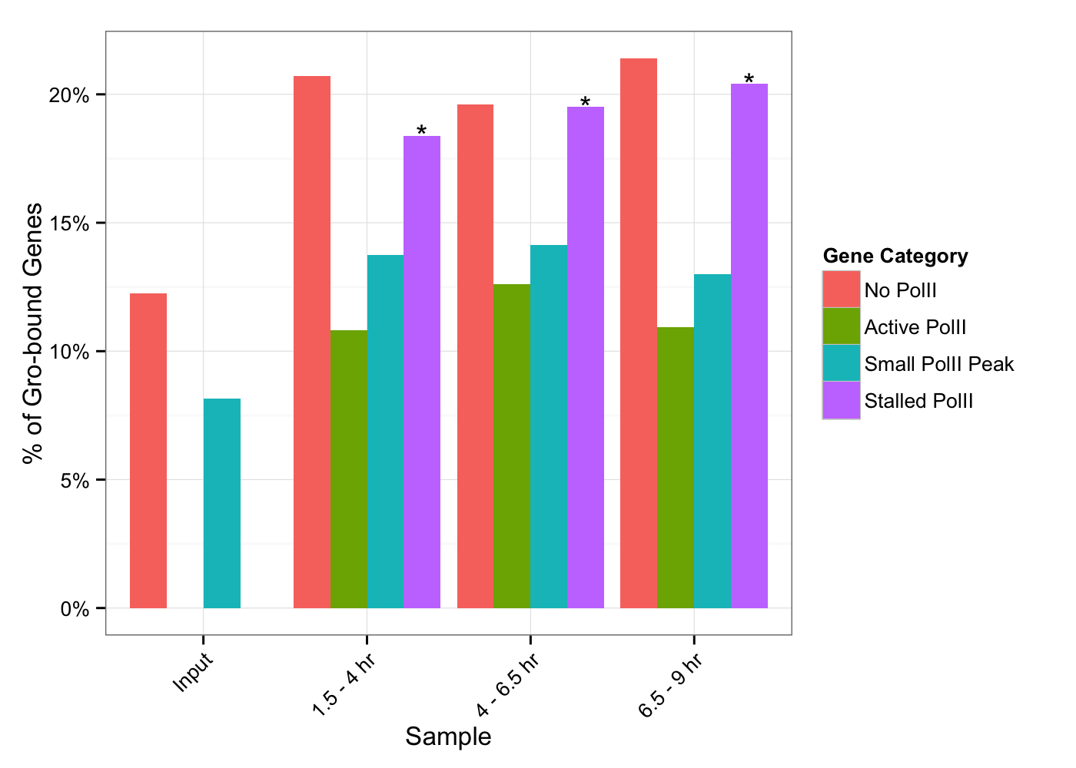

Slide 27
z-score
Anterior-posterior
*
*
*
*
*
Dorsal-ventral
*
1.5 – 4 hr
4 – 6.5 hr
6.5 - 9 hr

Slide 28
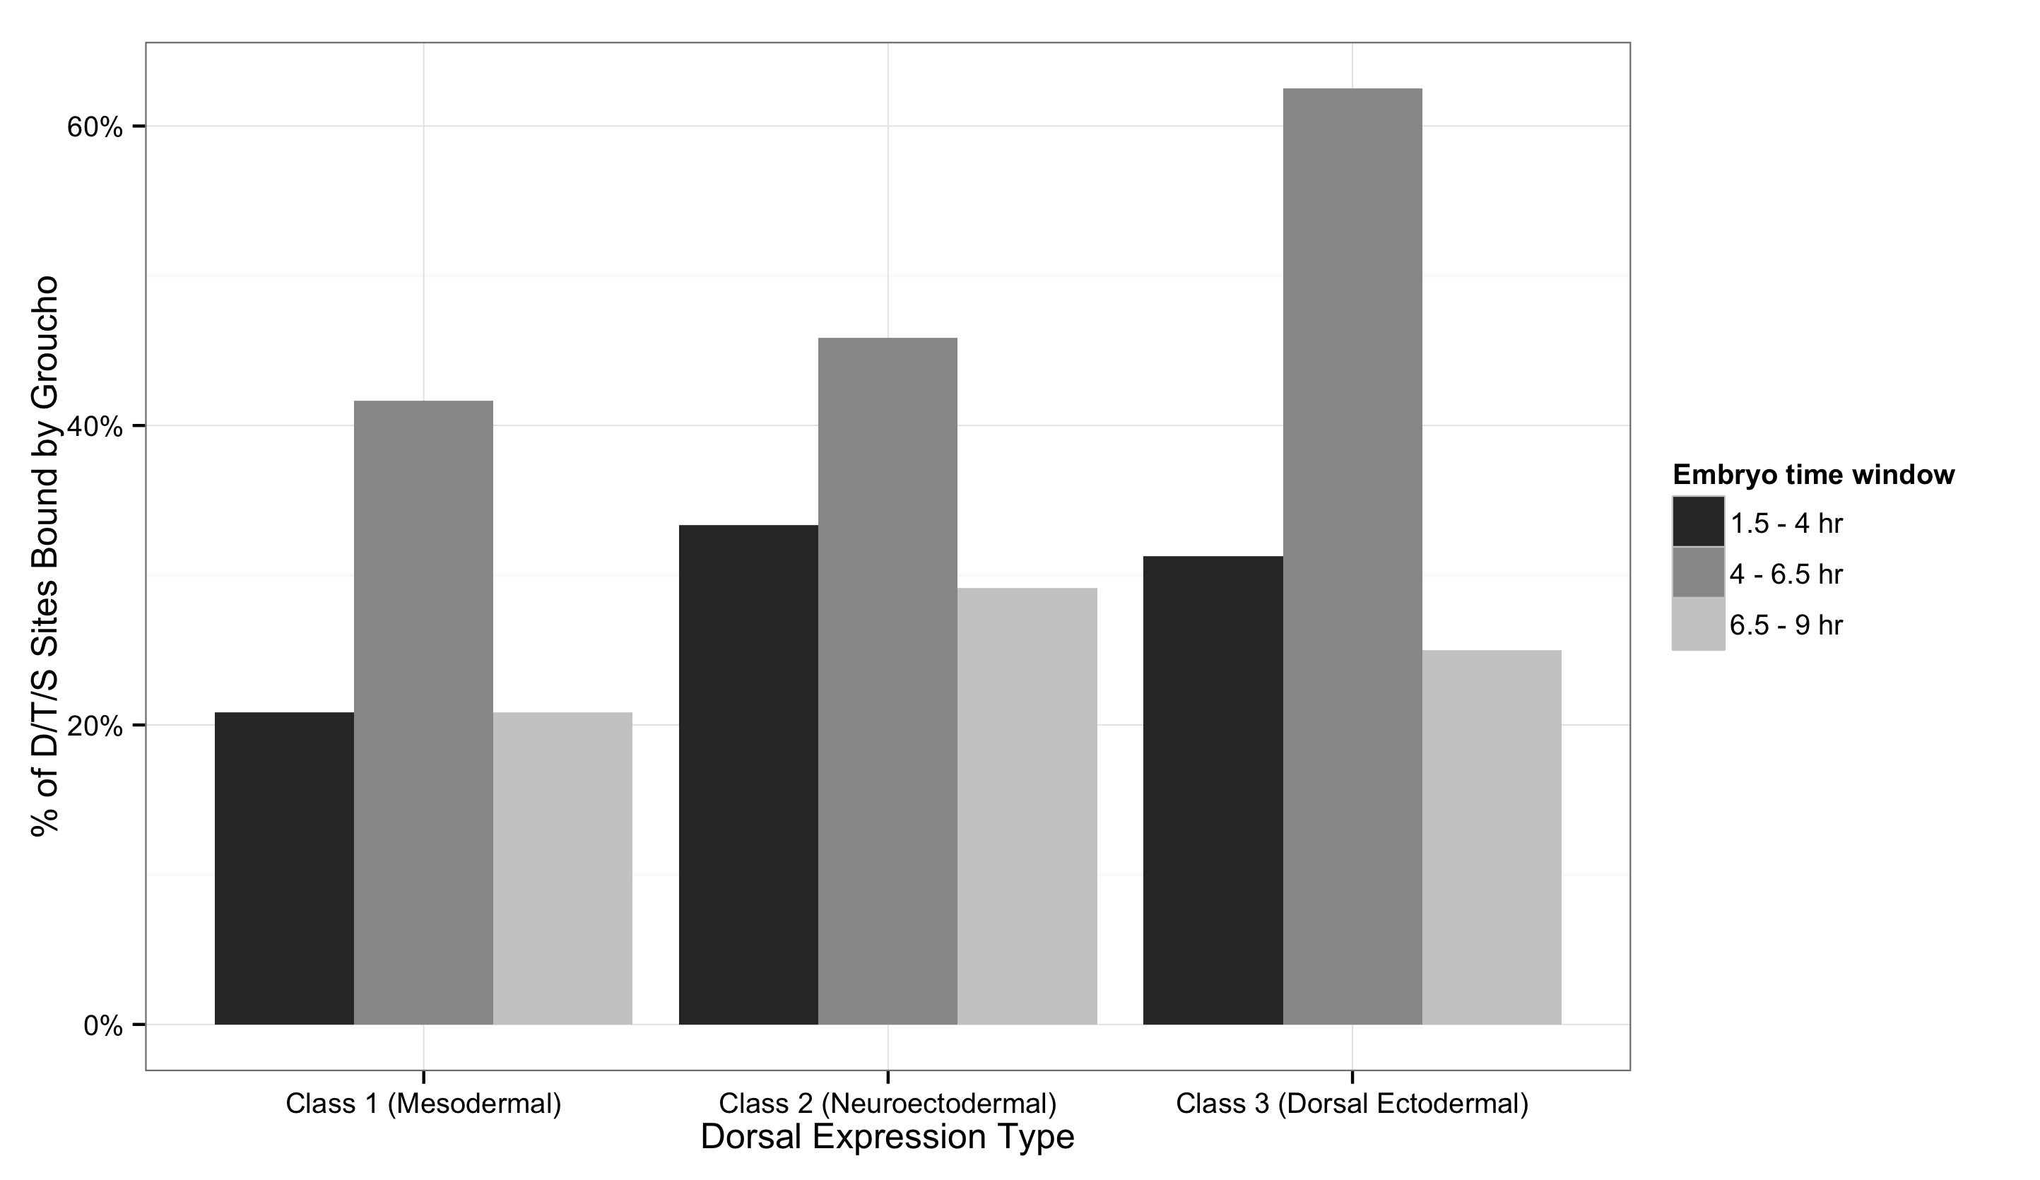
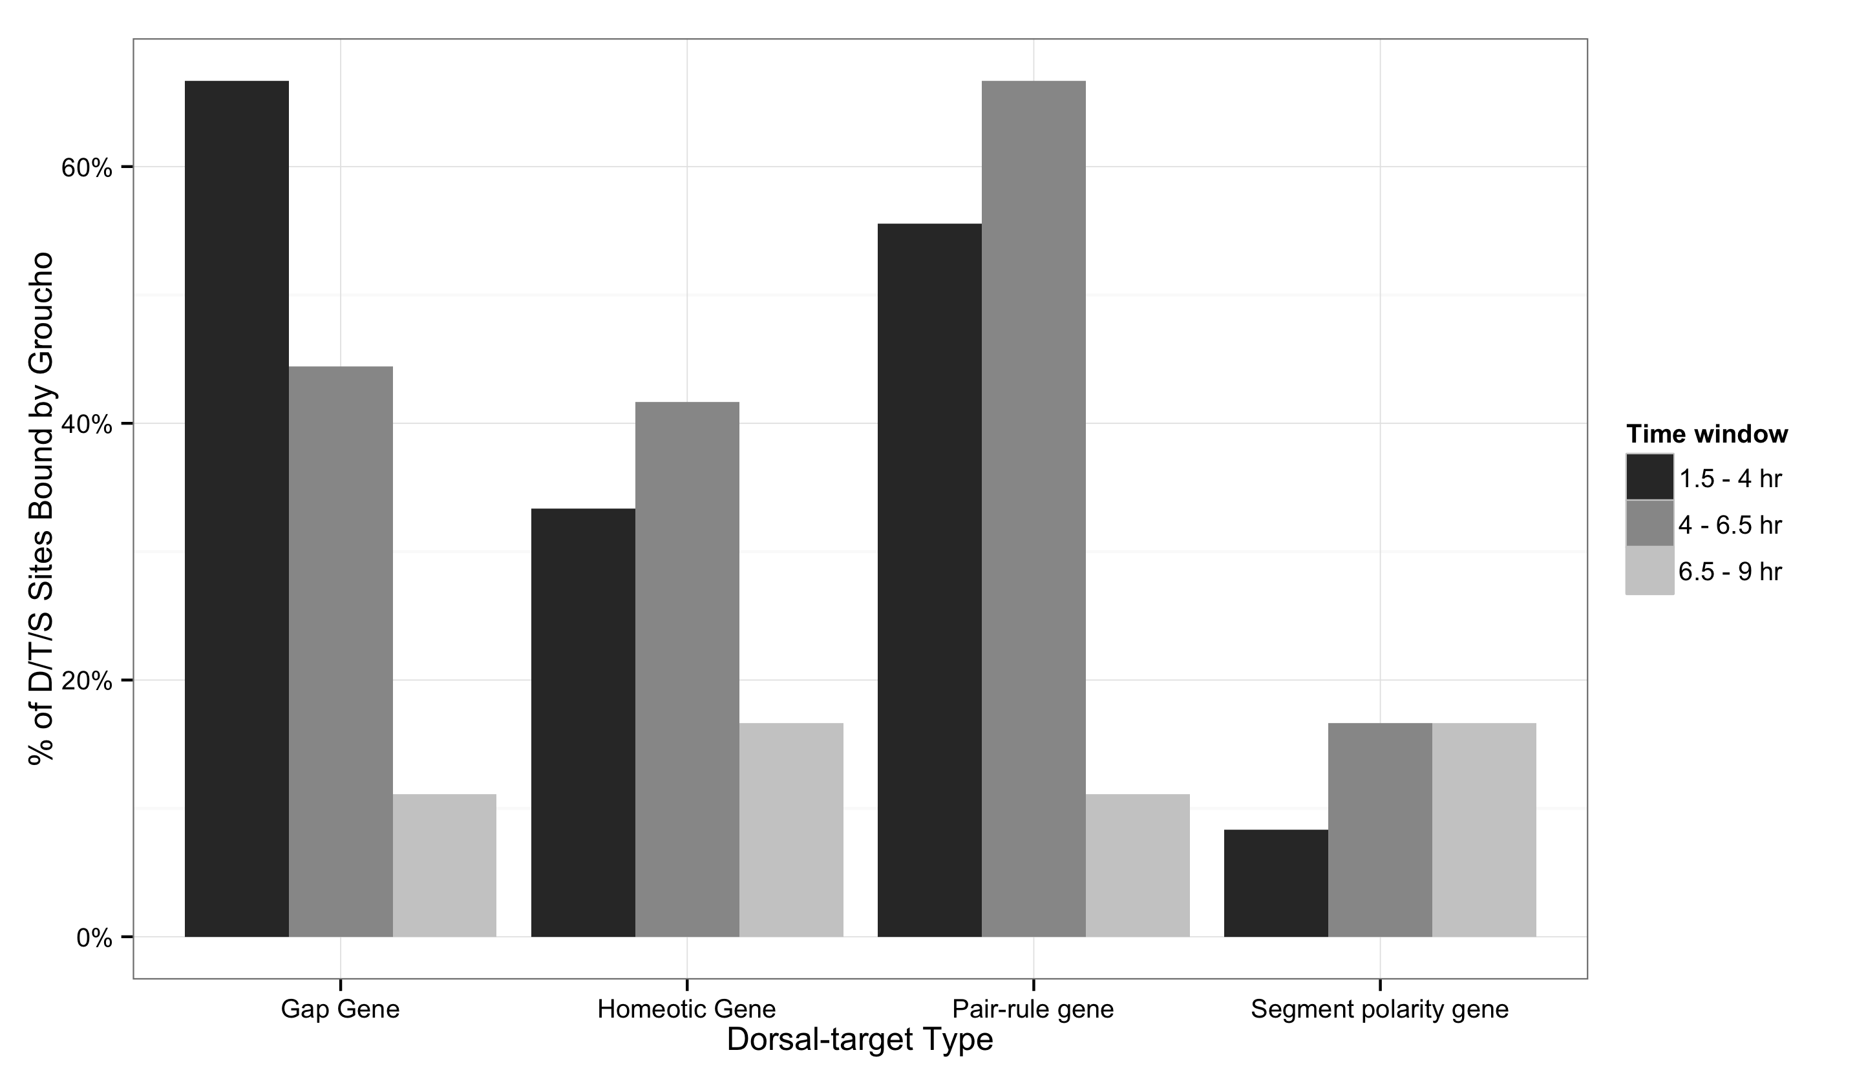
A
B

Slide 29
